Slide 1


Part II - Implementing Transformer from Scratch with Python & PyTorch
Quang Duong

Slide 2
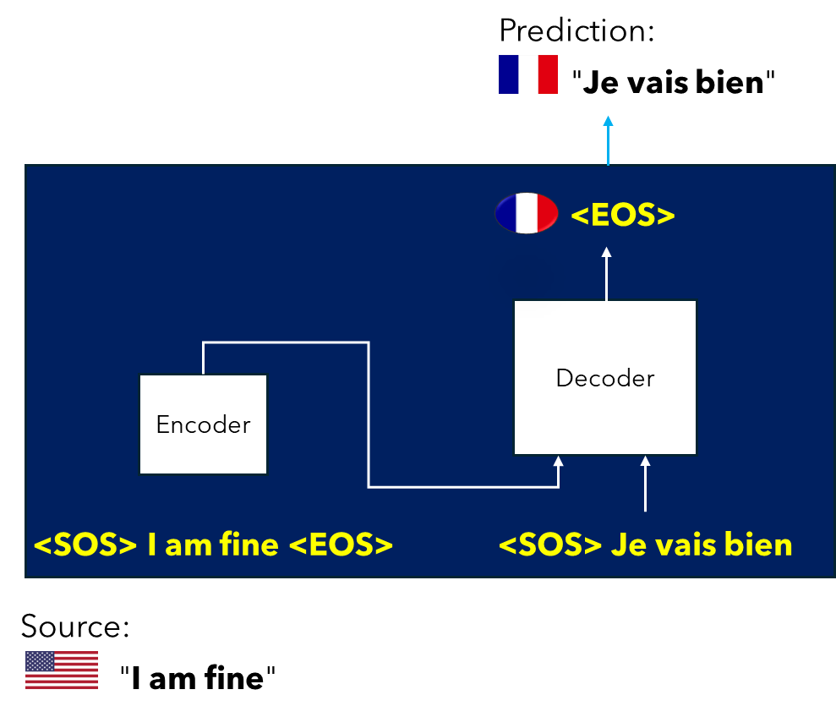
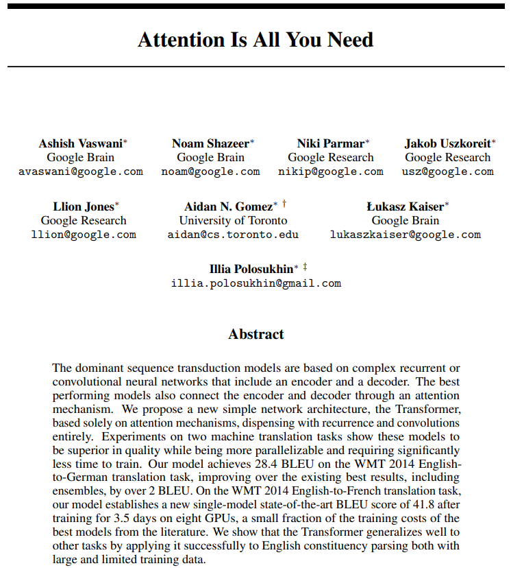
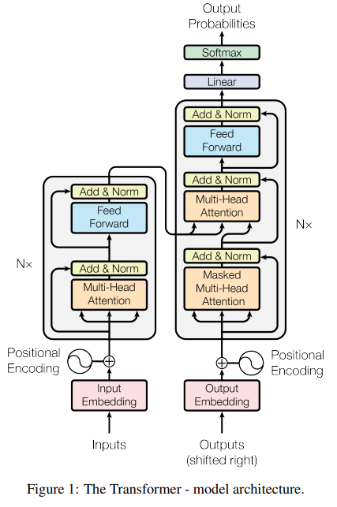
In the first part, …
Attention Is All You Need, A. Vaswani et al, 2017,
https://arxiv.org/abs/1706.03762

Slide 3
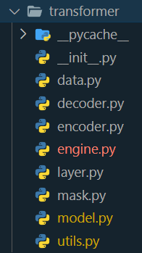
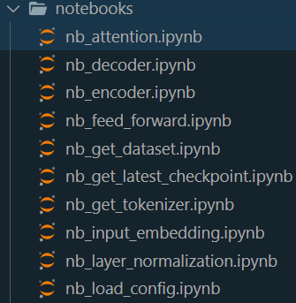
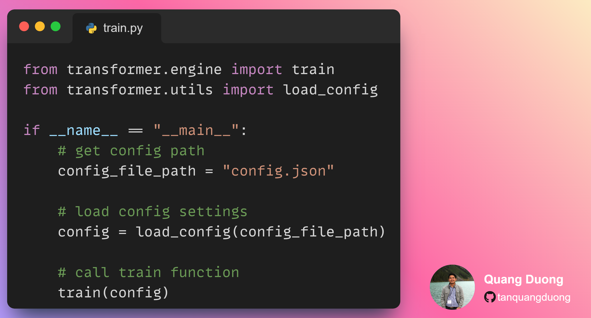
What we will obtain
Build a transformer package
Write train and inference scripts
Experimentation with notebooks

Slide 4
Software prerequisites for Python project

Slide 5


Software prerequisites for Python project
1.
IDE
VS Code, PyCharm, …
Including
A source code editor,
Build automation tools,
A debugger,
Code completion,
Syntax highlighting,
Version control integration, etc
Allowing developers to
Write, compile, test, and debug their code within a single interface
Popular IDEs
VS Code, PyCharm, Eclipse, etc

Slide 6


Software prerequisites for Python project
1.
IDE
VS Code, PyCharm, …
2.
Terminal
PowerShell (Windows), iTerm2(Mac OS), …
Used for
Command execution
File manipulation,
Program execution,
System administration tasks
Popular terminal applications
Windows: Command Prompt, PowerShell
Linux: Bash
macOS: iTerm2

Slide 7

Software prerequisites for Python project
1.
IDE
VS Code, PyCharm, …
2.
Terminal
PowerShell (Windows), iTerm2(Mac OS), …
Created by Guido van Rossum and first released in 1991
A high-level, interpreted programming language
Simplicity
Readability
Supports multiple programming paradigms
Procedural,
Object-oriented,
Functional programming.
Extensive standard library
Active community contribute to a vast ecosystem of frameworks and tools
3.
Python
Installing via: Python installer, Anaconda distributions

Slide 8
Software prerequisites for Python project
1.
IDE
VS Code, PyCharm, …
2.
Terminal
PowerShell (Windows), iTerm2(Mac OS), …
3.
Python
Installing via: Python installer, Anaconda distributions
A setup where Python and its related tools and libraries are installed and configured
To develop and
Run Python applications
Popular ways to create Python environment
Virtual Environment
Using venv or virtualenv
Conda Environment
Using conda
IDE tools like PyCharm, VS Code
4.
Python environment
`venv `, `conda`

Slide 9

Software prerequisites for Python project
1.
IDE
VS Code, PyCharm, …
2.
Terminal
PowerShell (Windows), iTerm2(Mac OS), …
3.
Python
Installing via: Python installer, Anaconda distributions
Collections of modules and functions that extend the capabilities of the Python programming language
To reuse code
To implement complex functionality without having to write it from scratch
Python Package Manager
pip, conda
4.
Python environment
`venv `, `conda`
5.
Python Packages
Pypi, Anaconda

Slide 10

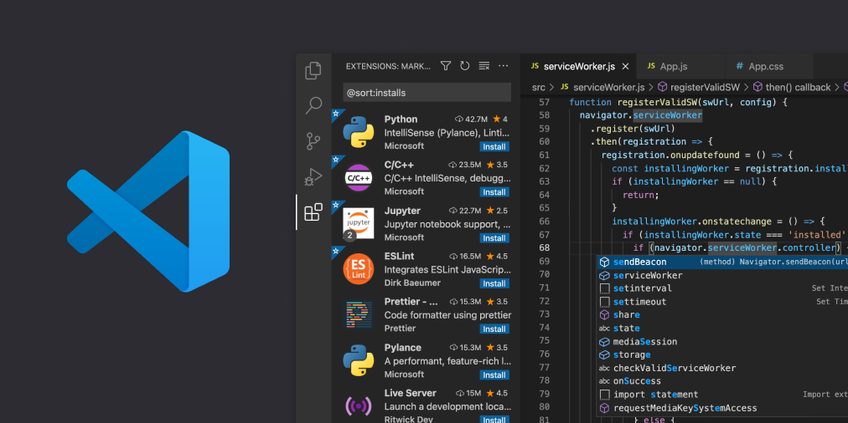
IDE
VS Code (https://code.visualstudio.com/download)

Slide 11
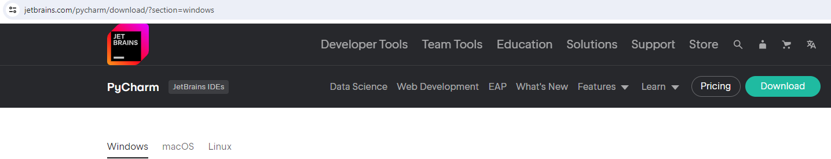
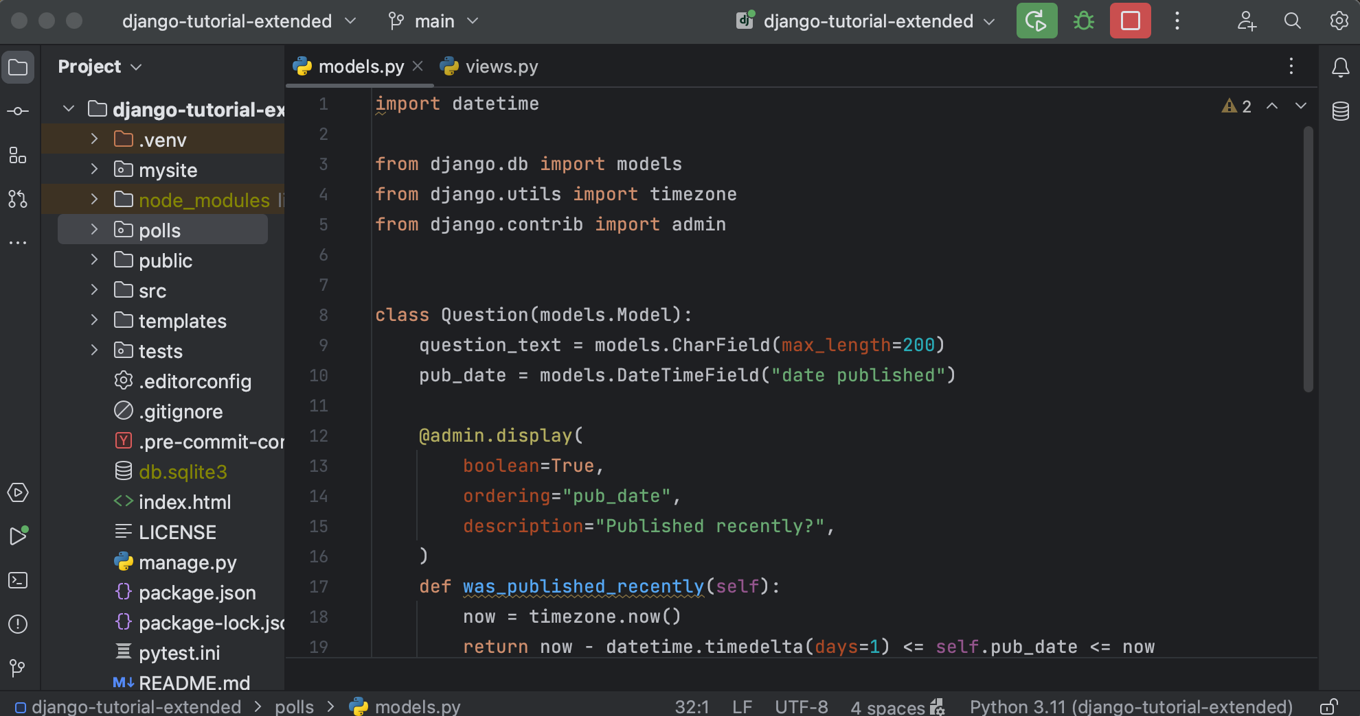

IDE
PyCharm (https://www.jetbrains.com/pycharm/download/?section=windows)

Slide 12

Terminal
Window: PowerShell, Command Prompt, Windows Terminal, Git Bash, WSL (Window Subsystem for Linux), …

Slide 13
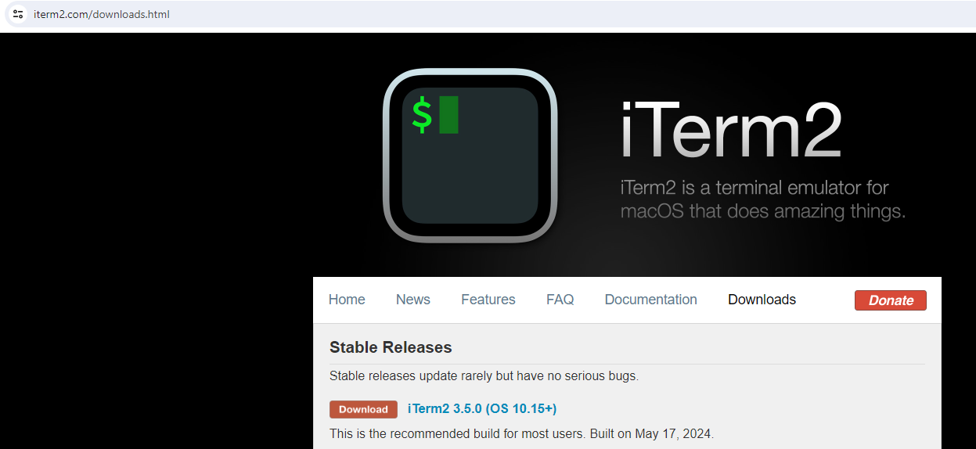
Terminal
Linux: Default terminal emulator, …
MacOS: Terminal, iTerm2 (https://iterm2.com/downloads.html), …

Slide 14

Python
Installing Python (https://www.python.org/downloads/)

Slide 15

Python
Or, install Anaconda with Python included (https://docs.anaconda.com/free/anaconda/install/)

Slide 16
Python environment
Using ` venv `, a module included in Python 3.3 & later versions
# Create Python environment with `venv`
# Navigate into the project directory
cd path/to/your/project # Create Python environment, eg. named ".myenv"
python -m venv .myenv
# (For Linux, MacOS, you may need to use `python3` instead of `python`)
# Activate ".myenv" environment
.myenv\Scripts\activate # For Window
source myenv/bin/activate # For Linux, MacOS
# Install required Python packages and start working. (Next slides)
# Deactivate ".myenv" environment after finishing the dev
deactivate

Slide 17
Python environment
Using `conda`
# Create Python environment with `conda`, eg. named "myenv"
conda create -n myenv python=3.10
# Activate "myenv" environment
conda activate myenv
# Install required Python packages and start working. (Next slides)
# Deactivate "myenv" environment after finishing the dev
conda deactivate

Slide 18
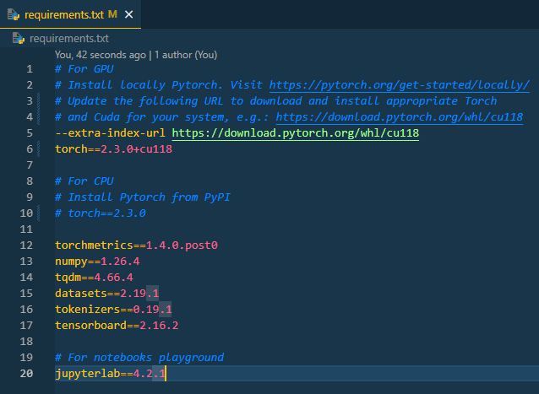
Python Package Installation
Activate Python environment
Using `pip` inside either venv or conda environment
Installing a Python package
`pip install package_name==version`
E.g. `pip install torch==2.3.0`
Installing all required packages in "requirements.txt"
`pip install –r requirements.txt`

Slide 19

What I use
IDE:
VS Code
Terminal (Windows):
For window: PowerShell
For Linux: Terminal
For macOS: iTerm2
Install Python and create environment:
conda (Anaconda)
Install Python packages:
pip
conda create -n myenv python=3.10 conda activate myenv
pip install –r requirements.txt

Slide 22

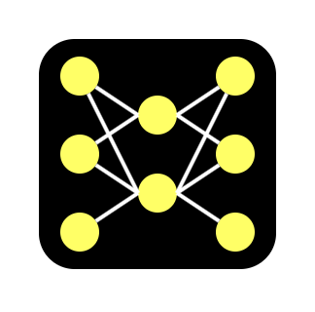


Implementation plan
Training
Inference
Source sentences
Training
Trained model
Target sentences
Trained model
Source sentence
Translated sentence

Slide 23
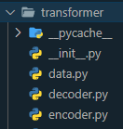
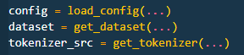
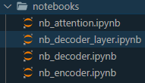
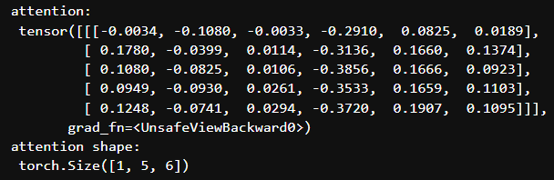
Implementation's formula
Source code
Coding step-by-step
Notebook
Example result
+
=
A good understanding of implementation
+
+

Slide 25
Training
Source sentences
Training
Trained model
Target sentences

Slide 27
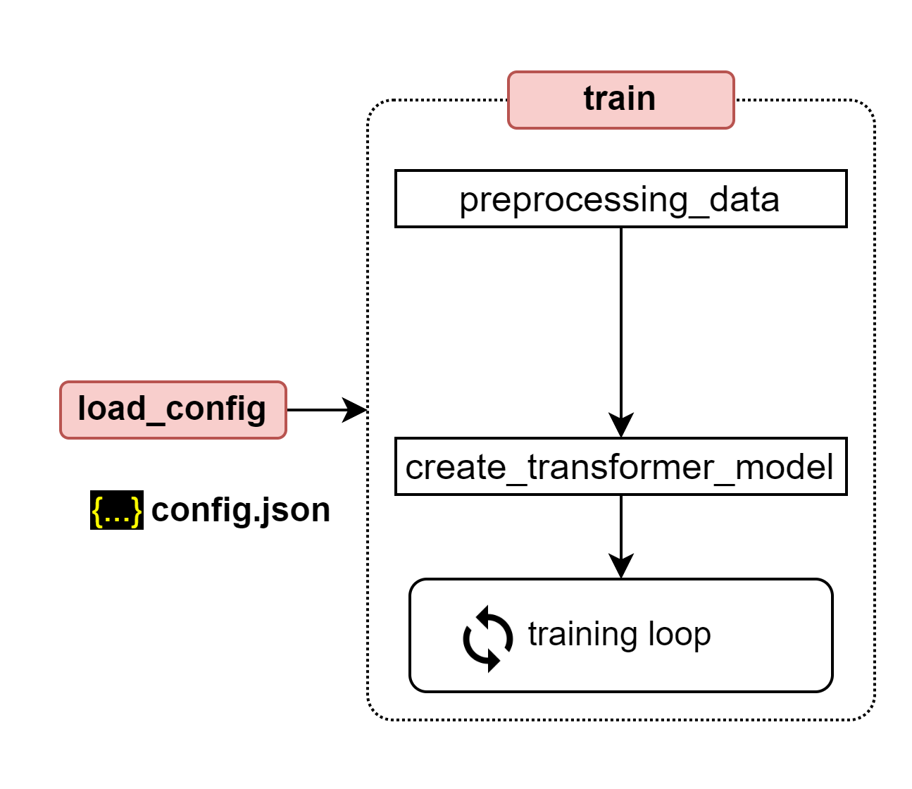
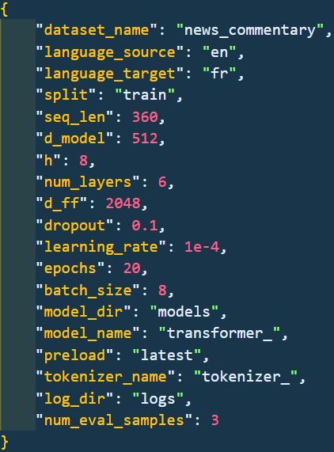
Training steps
Loading configuration

Slide 28
Training steps
Loading configuration
Training engine
Pre-processing data
Create and initiate transformer model
Training loop

Slide 29
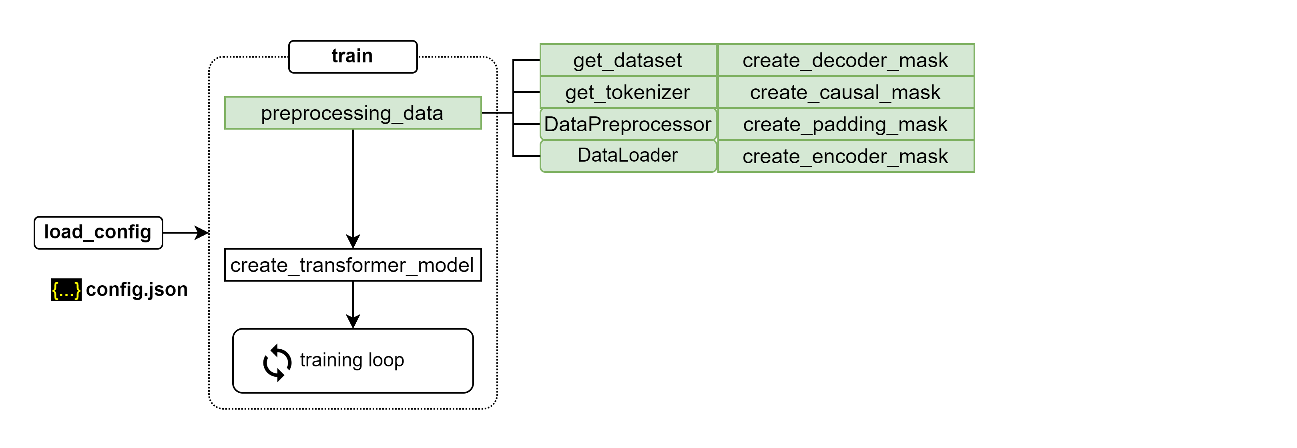
Preprocessing data

Slide 30
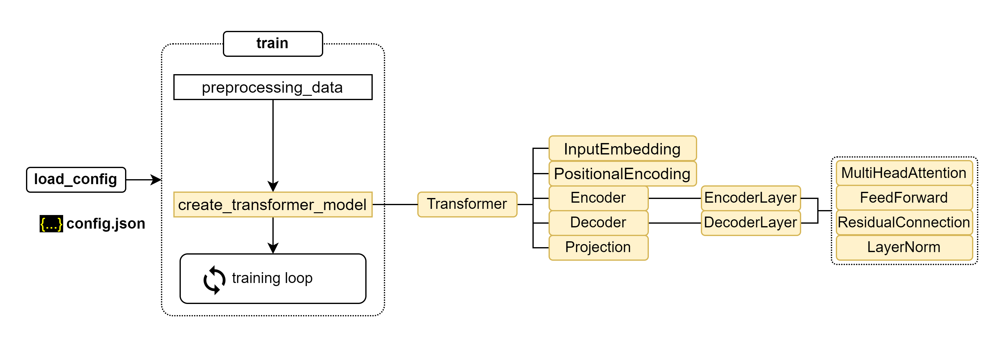
Create transformer model

Slide 31
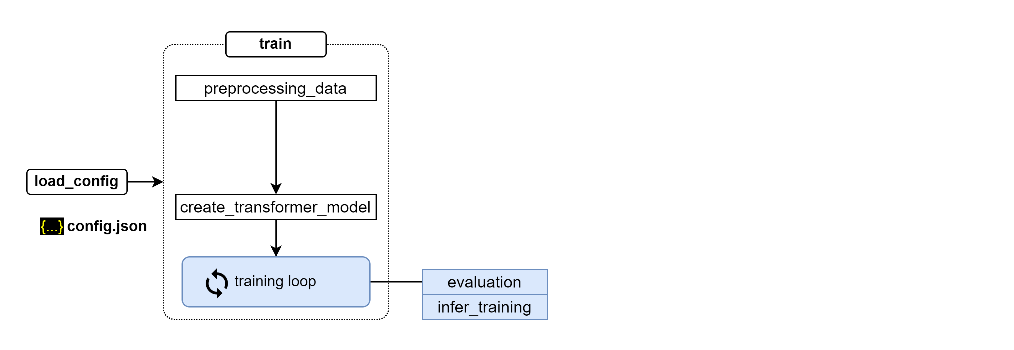
Training loop

Slide 32
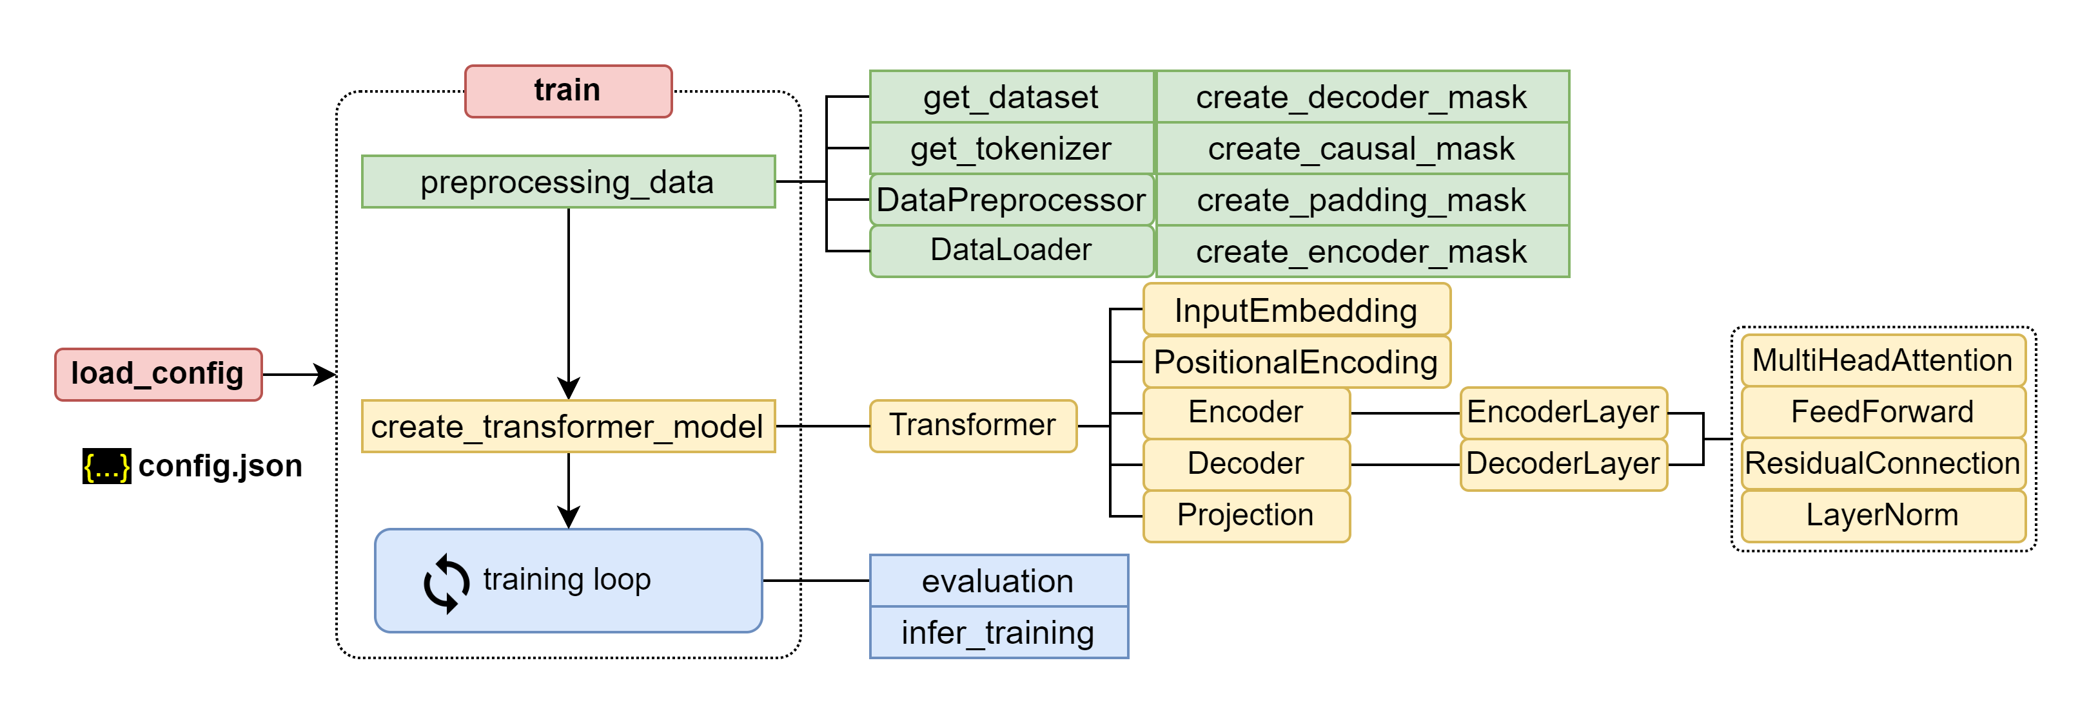
Put it all together

Slide 34
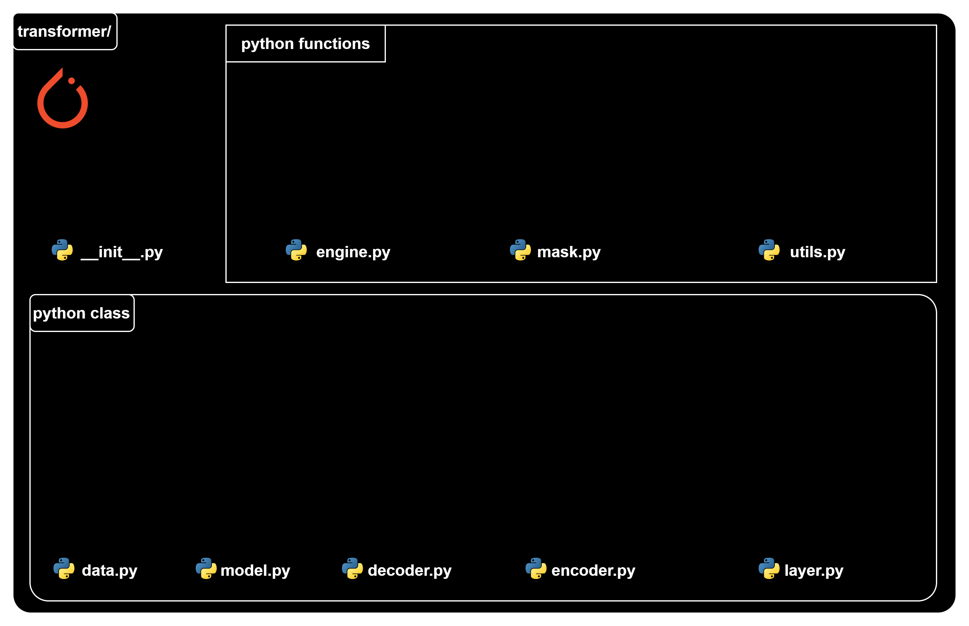
Source code structure

Slide 35
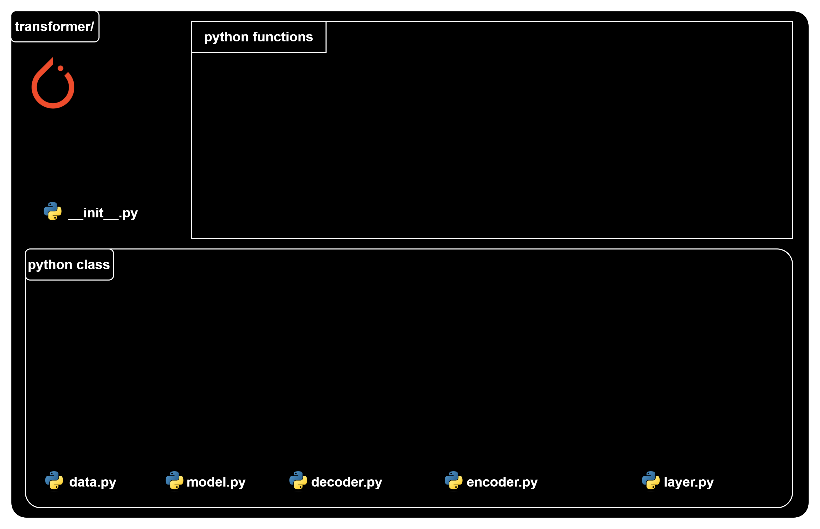
Transformer classes

Slide 36
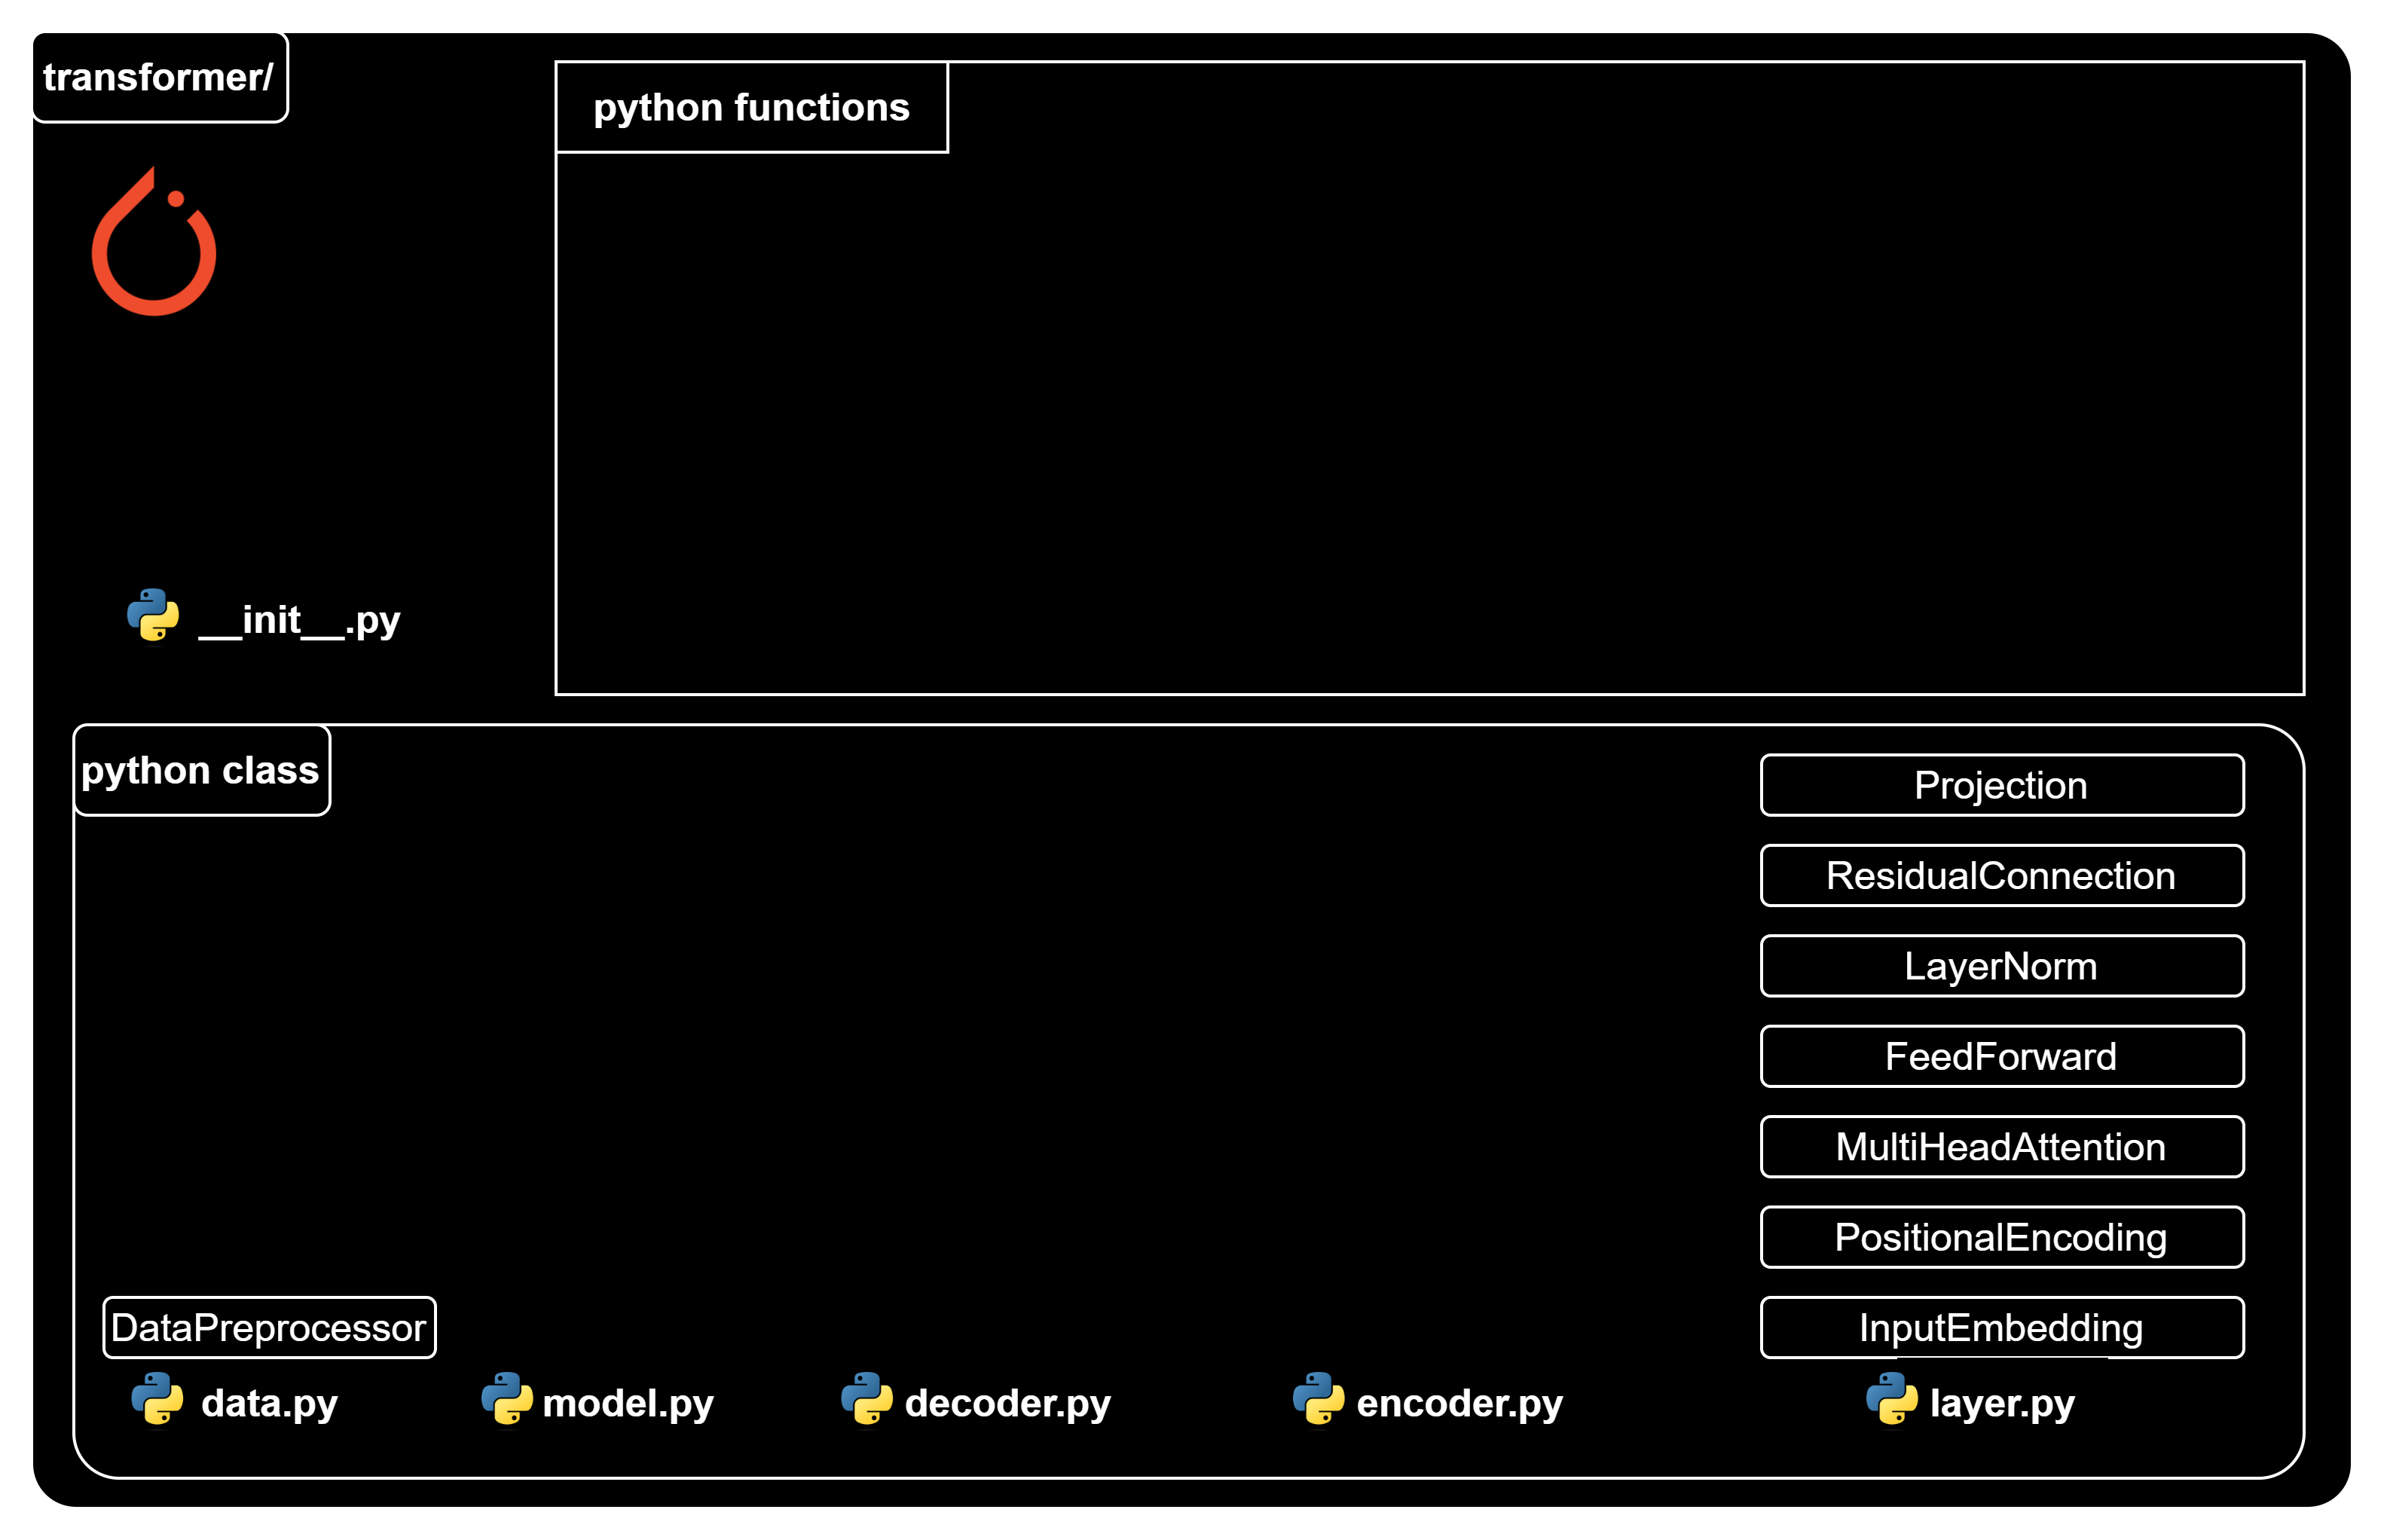
Transformer classes

Slide 37
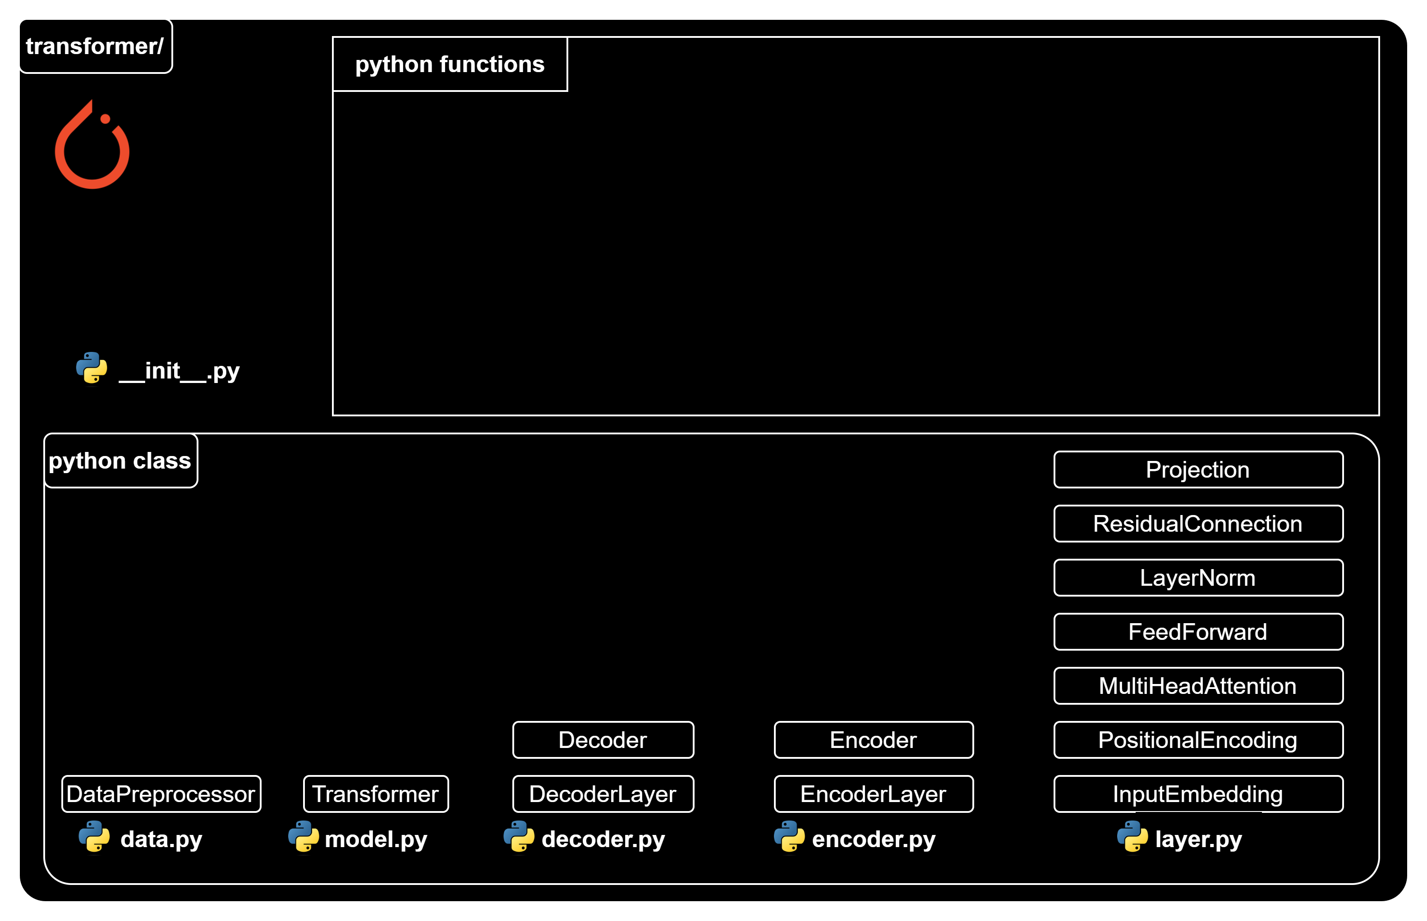
Transformer classes

Slide 38
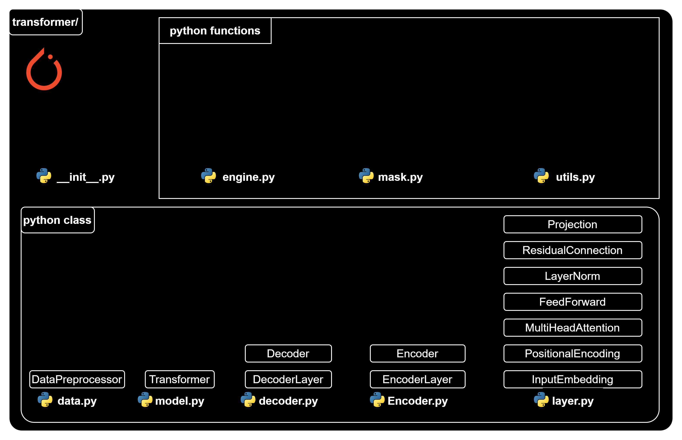
Transformer functions

Slide 39
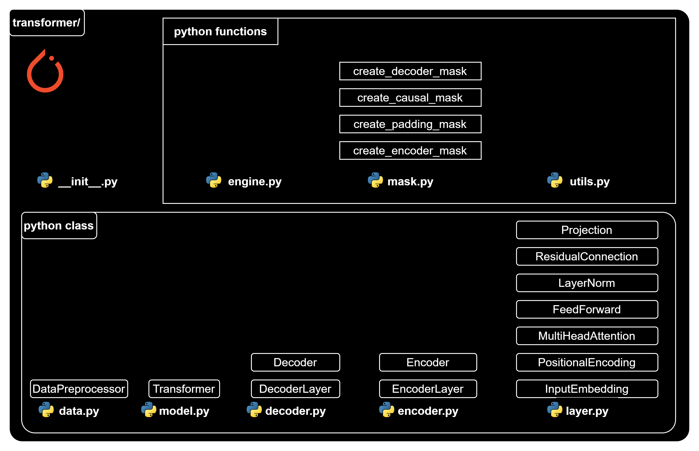
Transformer functions

Slide 40
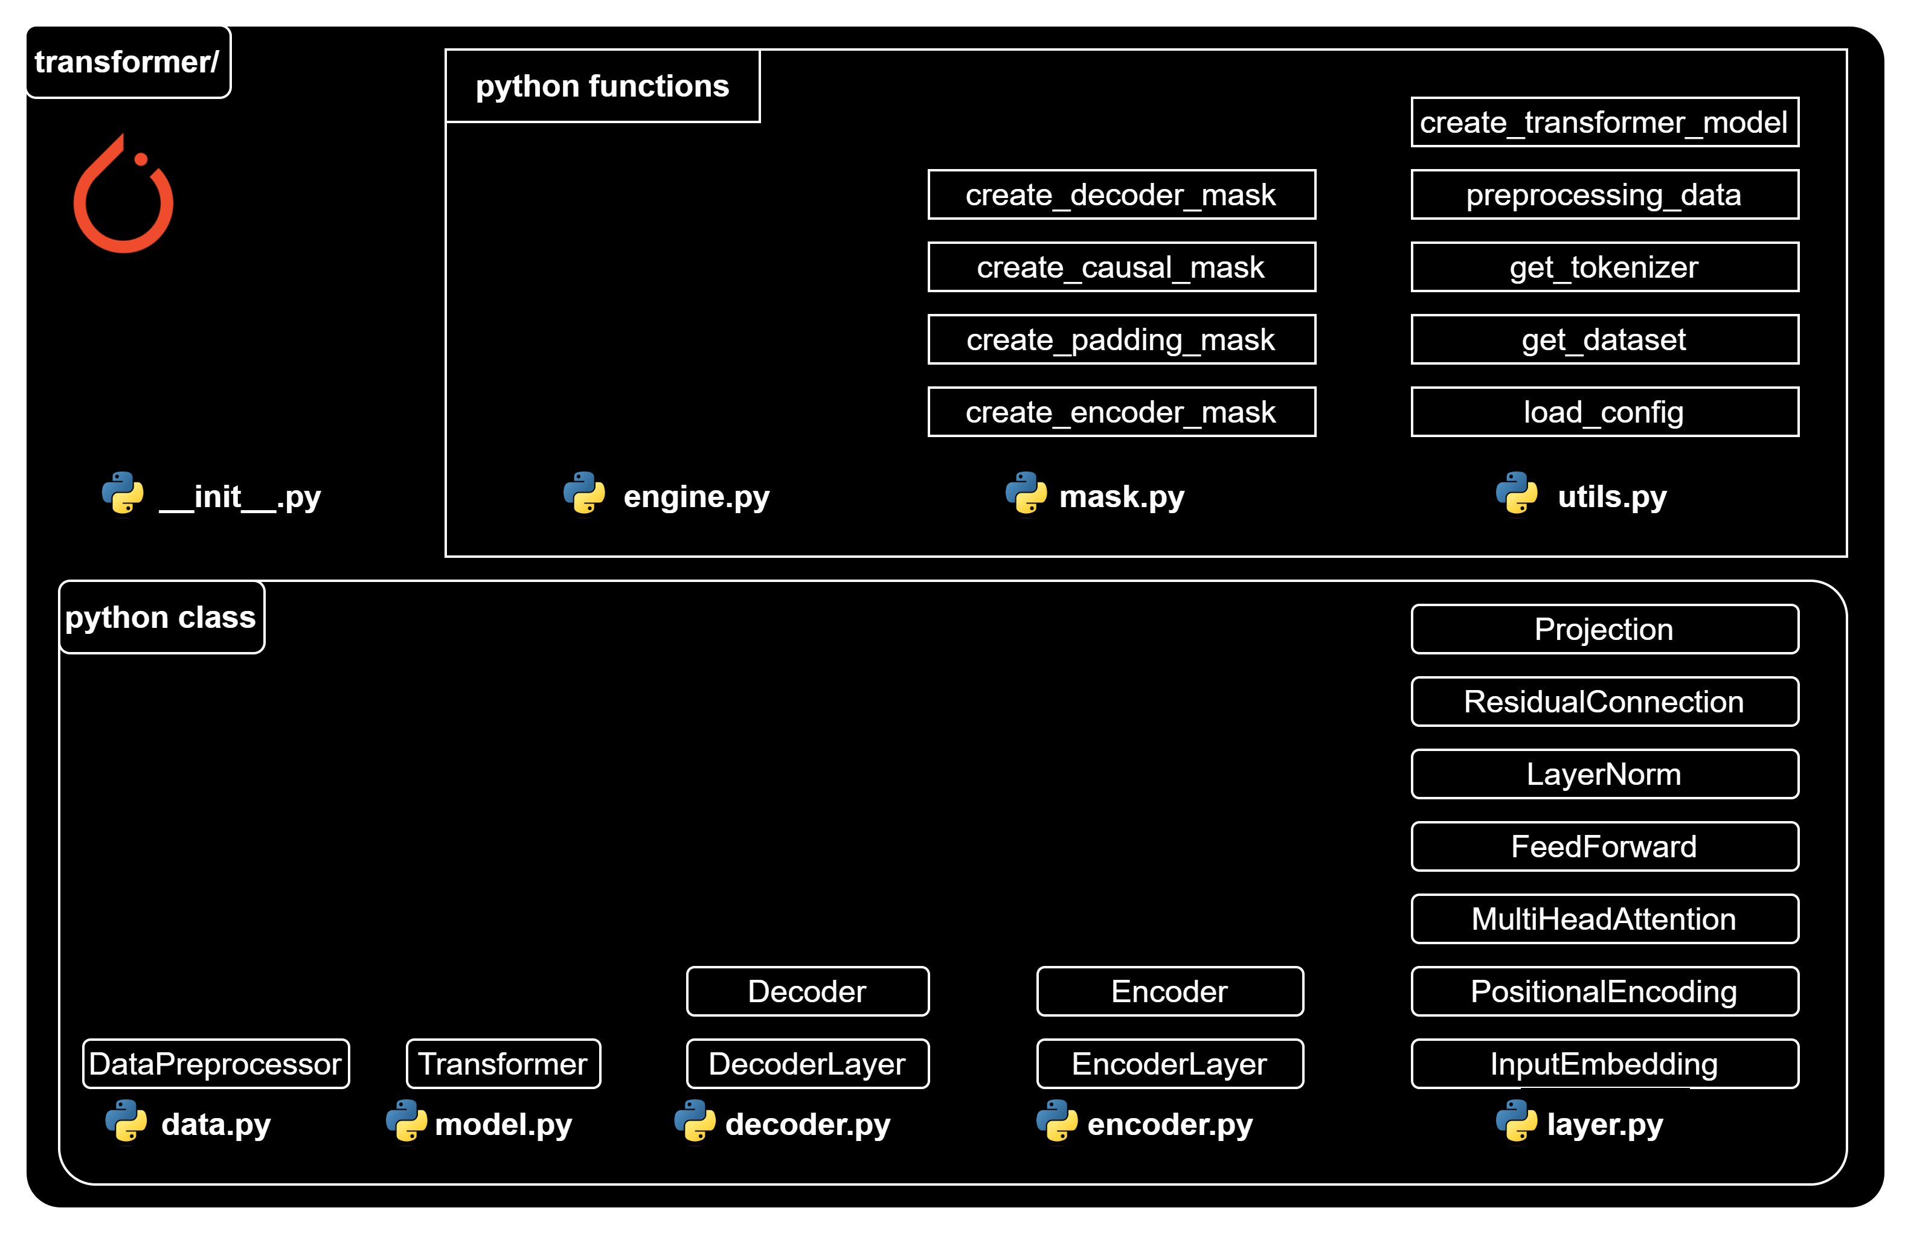
Transformer functions

Slide 41
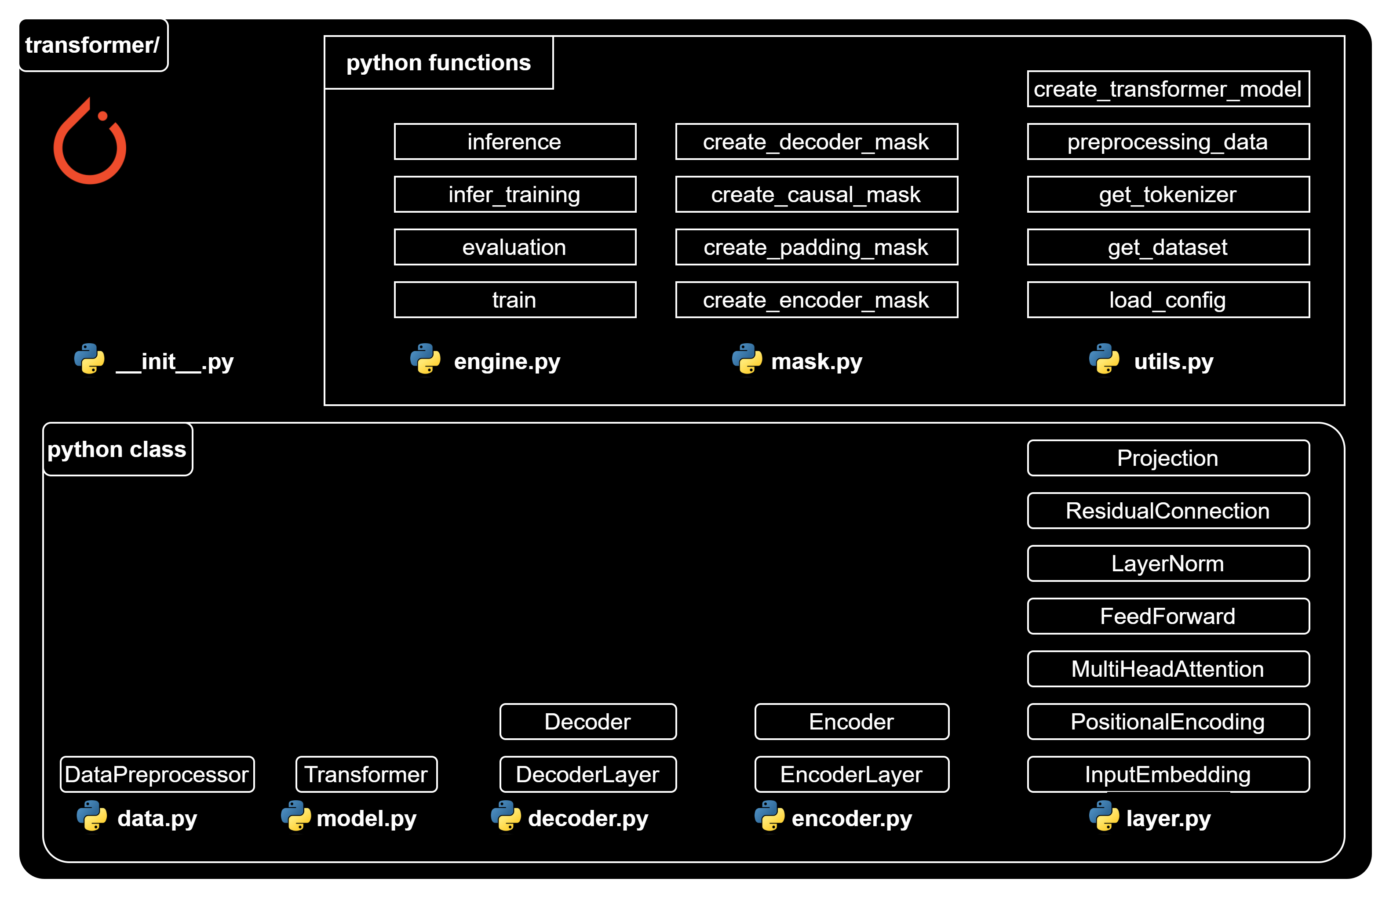
Transformer functions

Slide 44
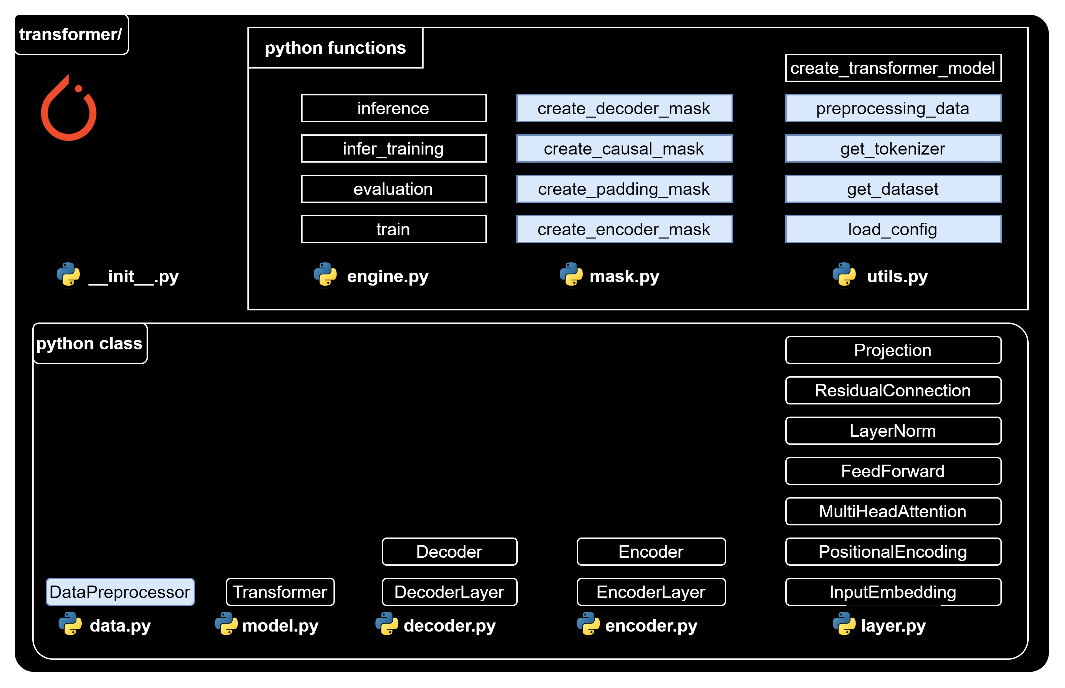
Data preparation function/class

Slide 46
Data preparation function/class

Slide 47

Utils – Load config
utils.py
import json
def load_config(config_file_path):
# Open the file in read mode
with open(config_file_path, "r") as f:
# Load the JSON content of the file into a Python dictionary
config = json.load(f)
# Return the configuration data
return config

Slide 48

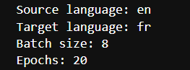
Playground– Load config
nb_load_config.ipynb
{…} config.json
import sys
sys.path.append('../')
from transformer.utils import load_config
config_file_path = "../config.json"
config = load_config(config_file_path)
print("Source language:", config['language_source'])
print("Target language:", config['language_target'])
print("Batch size:", config['batch_size'])
print("Epochs:", config['epochs'])

Slide 50
Data preparation function/class

Slide 51
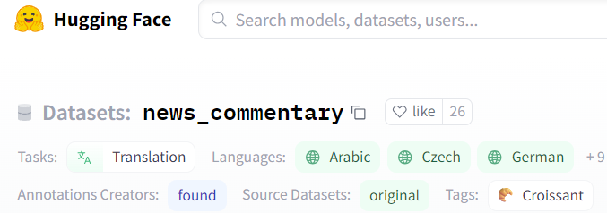
Utils – Get dataset
utils.py
from datasets import load_dataset
def get_dataset(config):
# Extract the dataset name, source language, target language, and split from the config
dataset_name = config["dataset_name"] # “news_commentary”
lang_src = config["language_source"] # “en”
lang_tgt = config["language_target"] # “fr”
split = config["split"] # “train”
# Construct the language pair string
language_pair = f"{lang_src}-{lang_tgt}"
# Load the dataset using the provided parameters
raw_dataset = load_dataset(dataset_name, language_pair, split=split)
# Return the loaded dataset
return raw_dataset

Slide 52
Playground – Get dataset
nb_get_dataset.ipynb
import sys
sys.path.append('../')
from transformer.utils import load_config, get_dataset
## Load config
config_file_path = "../config.json"
config = load_config(config_file_path)
# Load dataset
dataset = get_dataset(config)
print(dataset['translation'][:2])

Slide 54
Data preparation function/class

Slide 55
Utils – Get tokenizer
utils.py
from pathlib import Path
from tokenizers import Tokenizer, models, pre_tokenizers, trainers
def get_tokenizer(config, dataset, language):
# Extract the tokenizer name from the config and construct the tokenizer file path
tokenizer_name = config["tokenizer_name"]
tokenizer_path = f"{tokenizer_name}{language}.json"
# Check if a tokenizer file already exists at the specified path
if Path.exists(Path(tokenizer_path)):
# If it does, load the tokenizer from that file
tokenizer = Tokenizer.from_file(tokenizer_path)
else:
# If it doesn't, create a new tokenizer
tokenizer = Tokenizer(models.WordLevel(unk_token="[UNK]"))
tokenizer.pre_tokenizer = pre_tokenizers.Whitespace()

Slide 56
Utils – Get tokenizer
utils.py
# Create a trainer for the tokenizer
trainer = trainers.WordLevelTrainer(
min_frequency=2,
special_tokens=["[PAD]", "[UNK]", "[SOS]", "[EOS]"],
)
# Train the tokenizer on the provided dataset
tokenizer.train_from_iterator(
(item[language] for item in dataset["translation"]), trainer=trainer
)
# Save the trained tokenizer to the specified path
tokenizer.save(tokenizer_path)
# Return the tokenizer
return tokenizer

Slide 57
Playground – Get tokenizer
nb_get_tokenizer.ipynb
import sys
sys.path.append('../')
from transformer.utils import load_config, get_dataset, get_tokenizer
## Load config
config_file_path = "../config.json"
config = load_config(config_file_path)
# Load dataset
dataset = get_dataset(config)
print(dataset['translation'][:2])
## Load tokenizer
tokenizer_src = get_tokenizer(config, dataset, config['language_source'])
tokenizer_tgt = get_tokenizer(config, dataset, config['language_target'])

Slide 58
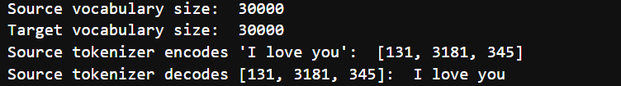
Playground – Get tokenizer
nb_get_tokenizer.ipynb
## Explore tokenizer
# check vocabulary size
print("Source vocabulary size: ", tokenizer_src.get_vocab_size())
print("Target vocabulary size: ", tokenizer_tgt.get_vocab_size())
# Check source tokenizer encodes/decodes
print("Source tokenizer encodes 'I love you': ", tokenizer_src.encode('I love you').ids)
print("Source tokenizer decodes [131, 3181, 345]: ", tokenizer_src.decode([131, 3181, 345]))

Slide 60
Data preparation function/class

Slide 62
Creating mask functions
mask.py
import torch
def create_encoder_mask(encoder_input_ids, pad_token_id):
return (encoder_input_ids != pad_token_id).unsqueeze(0).unsqueeze(0).int()
PAD token id
2
68
72
3
0
0
1
1
1
1
0
0
Encoder input ids
Encoder mask's output

Slide 63
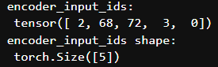
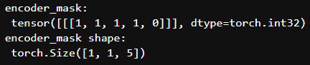
Playground – Create encoder mask
nb_mask.ipynb
import sys
sys.path.append('../')
import torch
from transformer.mask import *
# Create the inputs
en_input_ids = torch.tensor([ 2, 68, 72, 3, 0])
pad_id = torch.tensor([0]) # pad token id
# Create encoder mask
encoder_mask = create_encoder_mask(en_input_ids, pad_id) # (1, 1, seq_len)
print("encoder_input_ids: \n",
encoder_input_ids)
print("encoder_input_ids shape: \n",
encoder_input_ids.shape)
print("encoder_mask: \n", encoder_mask)
print("encoder_mask shape: \n",
encoder_mask.shape)

Slide 65
Creating mask functions
mask.py
import torch
def create_padding_mask(decoder_input_ids, pad_token_id):
return (decoder_input_ids != pad_token_id).unsqueeze(0).int()
PAD token id
2
68
72
3
0
0
1
1
1
1
0
0
Decoder input ids
Padding mask's output

Slide 66
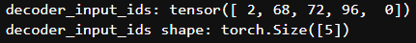
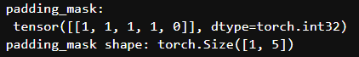
Playground – Create padding mask
nb_mask.ipynb
import sys
sys.path.append('../')
import torch
from transformer.mask import *
# Create the inputs
de_input_ids = torch.tensor([ 2, 68, 72, 96, 0])
pad_id = torch.tensor([0]) # pad token id
# Create padding mask # (1, seq_len)
padding_mask = create_padding_mask(de_input_ids, pad_id)
print("decoder_input_ids:",
decoder_input_ids)
print("decoder_input_ids shape:",
decoder_input_ids.shape)
print("padding_mask: \n", padding_mask)
print("padding_mask shape:", padding_mask.shape)

Slide 68
Creating mask functions
mask.py
import torch
def create_causal_mask(seq_len):
return (torch.triu(torch.ones((1, seq_len, seq_len)), diagonal=1).type(torch.int) == 0)
True
False
False
False
False
True
True
False
False
False
True
True
True
False
False
(1, 5, 5)
seq_len = 5
True
True
True
True
False
True
True
True
True
True
Causal mask's output

Slide 69
Creating mask functions
mask.py
import torch
def create_causal_mask(seq_len):
return (torch.triu(torch.ones((1, seq_len, seq_len)), diagonal=1).type(torch.int) == 0)
1
1
1
1
1
1
1
1
1
1
1
1
1
1
1
1
1
1
1
1
1
1
1
1
1

Slide 70
Creating mask functions
mask.py
import torch
def create_causal_mask(seq_len):
return (torch.triu(torch.ones((1, seq_len, seq_len)), diagonal=1).type(torch.int) == 0)
1
1
1
1
1
0
1
1
1
1
0
0
1
1
1
0
0
0
1
1
0
0
0
0
1

Slide 71
Creating mask functions
mask.py
import torch
def create_causal_mask(seq_len):
return (torch.triu(torch.ones((1, seq_len, seq_len)), diagonal=1).type(torch.int) == 0)
0
1
1
1
1
0
0
1
1
1
0
0
0
1
1
0
0
0
0
1
0
0
0
0
0

Slide 72
Creating mask functions
mask.py
import torch
def create_causal_mask(seq_len):
return (torch.triu(torch.ones((1, seq_len, seq_len)), diagonal=1).type(torch.int) == 0)
True
False
False
False
False
True
True
False
False
False
True
True
True
False
False
(1, 5, 5)
seq_len = 5
True
True
True
True
False
True
True
True
True
True
Causal mask's output

Slide 73
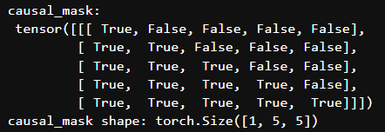
Playground – Create causal mask
nb_mask.ipynb
import sys
sys.path.append('../')
import torch
from transformer.mask import *
# Create the inputs
seq_len = 5 # sequence length
# Create a causal mask # (1, seq_len, seq_len)
causal_mask = create_causal_mask(seq_len)
print('causal_mask: \n', causal_mask)
print('causal_mask shape:', causal_mask.shape)

Slide 75
Creating mask functions
mask.py
import torch
def create_decoder_mask(decoder_input_ids, pad_token_id, seq_len):
padding_mask = create_padding_mask(decoder_input_ids, pad_token_id)
causal_mask = create_causal_mask(seq_len)
return padding_mask & causal_mask

Slide 76
Creating mask functions
mask.py
import torch
def create_decoder_mask(decoder_input_ids, pad_token_id, seq_len):
padding_mask = create_padding_mask(decoder_input_ids, pad_token_id)
causal_mask = create_causal_mask(seq_len)
return padding_mask & causal_mask
2
68
72
3
0
Decoder input ids
1
1
1
1
0
Padding mask's output

Slide 77
Creating mask functions
mask.py
import torch
def create_decoder_mask(decoder_input_ids, pad_token_id, seq_len):
padding_mask = create_padding_mask(decoder_input_ids, pad_token_id)
causal_mask = create_causal_mask(seq_len)
return padding_mask & causal_mask
2
68
72
3
0
True
False
False
False
False
True
True
False
False
False
Decoder input ids
True
True
True
False
False
1
1
1
1
0
True
True
True
True
False
True
True
True
True
True
Padding mask's output
Causal mask's output

Slide 78
Creating mask functions
mask.py
import torch
def create_decoder_mask(decoder_input_ids, pad_token_id, seq_len):
padding_mask = create_padding_mask(decoder_input_ids, pad_token_id)
causal_mask = create_causal_mask(seq_len)
return padding_mask & causal_mask
2
68
72
3
0
True
False
False
False
False
1
0
0
0
0
True
True
False
False
False
1
1
0
0
0
Decoder input ids
True
True
True
False
False
1
1
1
0
0
1
1
1
1
0
True
True
True
True
False
1
1
1
1
0
&
=
True
True
True
True
True
1
1
1
1
0
Padding mask's output
Causal mask's output
Decoder mask's output

Slide 79
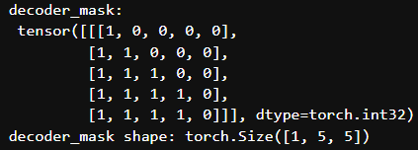
Playground – Create decoder mask
nb_mask.ipynb
import sys
sys.path.append('../')
import torch
from transformer.mask import *
# Create the inputs
de_input_ids = torch.tensor([ 2, 68, 72, 96, 0])
pad_id = torch.tensor([0]) # pad token id
seq_len = 5 # sequence length
# Create decoder mask # (1, seq_len, seq_len)
decoder_mask = create_decoder_mask(de_input_ids, pad_id, seq_len)
print("decoder_input_ids:",
decoder_input_ids)
print("decoder_input_ids shape:",
decoder_input_ids.shape)
print('decoder_mask: \n', decoder_mask)
print('decoder_mask shape:', decoder_mask.shape)

Slide 81
Data preparation function/class

Slide 82
Data – Data Preprocessor class
data.py
import torch
from torch.utils.data import Dataset
from transformer.mask import create_encoder_mask, create_decoder_mask
class DataPreprocessor(Dataset):
def __init__(self, dataset, tokenizer_src, tokenizer_tgt, language_src, language_tgt, seq_len):
super().__init__()
# Store the parameters.
self.dataset = dataset
self.tokenizer_src = tokenizer_src
self.tokenizer_tgt = tokenizer_tgt
self.language_src = language_src
self.language_tgt = language_tgt
self.seq_len = seq_len

Slide 83
Data – Data Preprocessor class
data.py
# Get the token ids for the special tokens.
self.sos_token_id = torch.tensor([self.tokenizer_src.token_to_id('[SOS]')], dtype=torch.int64)
self.eos_token_id = torch.tensor([self.tokenizer_src.token_to_id('[EOS]')], dtype=torch.int64)
self.pad_token_id = torch.tensor([self.tokenizer_src.token_to_id('[PAD]')], dtype=torch.int64)
# The __len__ method returns the number of items in the dataset.
def __len__(self):
return len(self.dataset)

Slide 84
Data – Data Preprocessor class
data.py
# The __getitem__ method returns the preprocessed data for the item at the given index.
def __getitem__(self, idx):
# Get the item from the dataset.
item = self.dataset[idx]
# Get the source and target texts from the item.
text_src = item['translation'][self.language_src]
text_tgt = item['translation'][self.language_tgt]
# Tokenize the source and target texts.
encoder_token_ids = torch.tensor(self.tokenizer_src.encode(text_src).ids, dtype=torch.int64)
decoder_token_ids = torch.tensor(self.tokenizer_tgt.encode(text_tgt).ids, dtype=torch.int64)
# Calculate the number of padding tokens needed for the encoder and decoder inputs.
encoder_padding_num = self.seq_len - len(encoder_token_ids) - 2 # 2: SOS & EOS
decoder_padding_num = self.seq_len - len(decoder_token_ids) - 1 # 1: SOS

Slide 85
Data – Data Preprocessor class
data.py
# Create the encoder and decoder inputs and the decoder target.
encoder_input_ids = torch.cat(
[
self.sos_token_id,
encoder_token_ids,
self.eos_token_id,
self.pad_token_id.repeat(encoder_padding_num),
])
decoder_input_ids = torch.cat(
[
self.sos_token_id,
decoder_token_ids,
self.pad_token_id.repeat(decoder_padding_num),
])
decoder_target_ids = torch.cat(
[
decoder_token_ids,
self.eos_token_id,
self.pad_token_id.repeat(decoder_padding_num),
]) # (seq_len)

Slide 86
Data – Data Preprocessor class
data.py
# Create the masks for the encoder and decoder inputs, (1, 1, seq_len)
encoder_mask = create_encoder_mask(encoder_input_ids, self.pad_token_id)
# Create the masks for the decoder inputs (1, seq_len, seq_len)
decoder_mask = create_decoder_mask(decoder_input_ids, self.pad_token_id, self.seq_len)
# Return the preprocessed data.
output = {
"text_src": text_src,
"text_tgt": text_tgt,
"encoder_input_ids": encoder_input_ids,
"decoder_input_ids": decoder_input_ids,
"decoder_target_ids": decoder_target_ids,
"encoder_mask": encoder_mask,
"decoder_mask": decoder_mask
}
return output

Slide 88
Data preparation function/class

Slide 89
Utils – Preprocessing data
utils.py
def preprocessing_data(config):
# Get the raw dataset
raw_dataset = get_dataset(config)
# Initialize tokenizers for the source & target languages
tokenizer_src = get_tokenizer(config, raw_dataset, config["language_source"])
tokenizer_tgt = get_tokenizer(config, raw_dataset, config["language_target"])
# Calculate the sizes of the training, validation, and test sets
train_ds_size = int(len(raw_dataset) * 0.7)
val_ds_size = int(len(raw_dataset) * 0.2)
test_ds_size = len(raw_dataset) - train_ds_size - val_ds_size
# Split the raw dataset into training, validation, and test sets
train_raw_dataset, val_raw_dataset, test_raw_dataset = random_split(raw_dataset, [train_ds_size, val_ds_size, test_ds_size])

Slide 90
Utils – Preprocessing data
utils.py
# Preprocess the training, validation, and test sets
train_ds = DataPreprocessor(
train_raw_dataset, tokenizer_src, tokenizer_tgt,
config["language_source"],
config["language_target"],
config["seq_len"],)
val_ds = DataPreprocessor(
val_raw_dataset, tokenizer_src, tokenizer_tgt,
config["language_source"],
config["language_target"],
config["seq_len"],)
test_ds = DataPreprocessor(
test_raw_dataset, tokenizer_src, tokenizer_tgt,
config["language_source"],
config["language_target"],
config["seq_len"],)

Slide 91
Utils – Preprocessing data
utils.py
# Create DataLoaders for the training, validation, and test sets
train_dataloader = DataLoader(train_ds, batch_size=config["batch_size"], shuffle=True)
val_dataloader = DataLoader(val_ds, batch_size=1, shuffle=True)
test_dataloader = DataLoader(test_ds, batch_size=1, shuffle=True)
return (
train_dataloader,
val_dataloader,
test_dataloader,
tokenizer_src,
tokenizer_tgt,
)

Slide 93
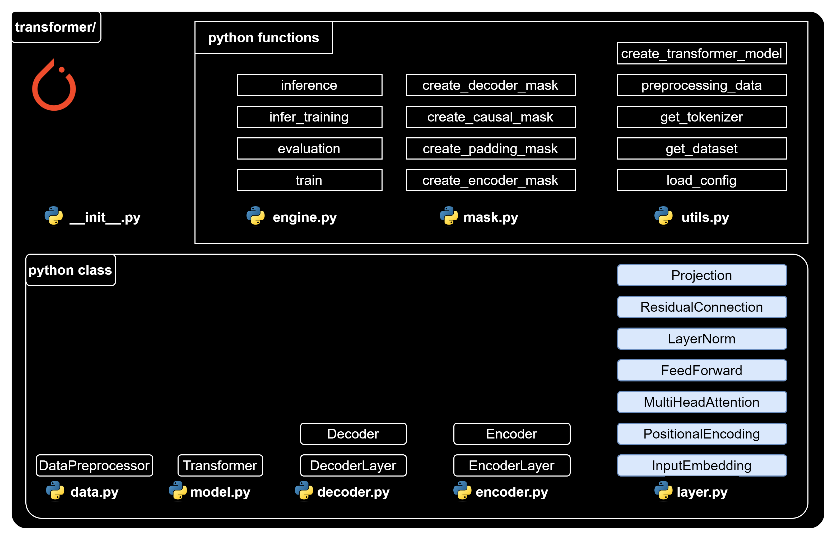
Transformer building block

Slide 95
Transformer building block

Slide 96
Layer – Input Embedding
layer.py
import torch
import torch.nn as nn
import math
class InputEmbedding(nn.Module):
def __init__(self, vocab_size, d_model):
super().__init__()
self.embedding = nn.Embedding(vocab_size, d_model)
self.d_model = d_model
def forward(self, x): # x: [batch_size, seq_len]
# Apply the embedding layer to the input,
# and then scales the result by the square root of the embedding dimensionality.
return self.embedding(x) * math.sqrt(self.d_model) # [batch_size, seq_len, d_model].

Slide 97
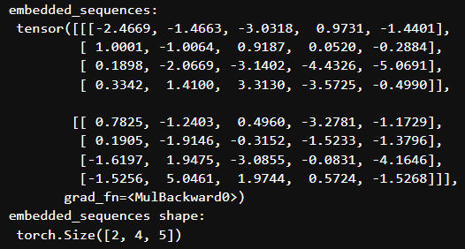
Layer – Input Embedding
nb_input_embedding.ipynb
import sys
sys.path.append('../')
import torch
from transformer.layer import InputEmbedding
# Initiate parammeters
vocab_size = 10
d_model = 5
# Create an instance of our InputEmbedding class
input_embedding = InputEmbedding(vocab_size, d_model)
# Suppose a batch of 2 sequences
sequences = torch.tensor([[1, 2, 3, 4], [5, 6, 7, 8]])
# Pass our sequences through the input embedding
embedded_sequences = input_embedding(sequences)
print("embedded_sequences: \n", embedded_sequences)
print("embedded_sequences shape: \n", embedded_sequences.shape)

Slide 99
Transformer building block

Slide 100
Layer – Positional Encoding
layer.py
import torch
import torch.nn as nn
class PositionalEncoding(nn.Module):
def __init__(self, d_model: int, seq_len: int, dropout: float) -> None:
super().__init__()
self.dropout = nn.Dropout(dropout)
# Compute the positional encodings once in log space.
position = torch.arange(0, seq_len, dtype=torch.float).unsqueeze(1)
base = 10000.0 ** (-1.0 / d_model)
div_term = torch.pow(base, torch.arange(0, d_model, 2).float()) # Compute the positional encodings
pe = torch.zeros(seq_len, d_model)
pe[:, 0::2] = torch.sin(position * div_term)
pe[:, 1::2] = torch.cos(position * div_term)
pe = pe.unsqueeze(0) # Register the positional encodings as a buffer.
self.register_buffer("pe", pe)

Slide 101
Layer – Positional Encoding
layer.py
def forward(self, x): # x(embeded sequence): [batch_size, seq_len, d_model]
# Add the positional encodings to the input embeddings,
# Then apply dropout to the result.
x = x + (self.pe[:, : x.shape[1], :]).requires_grad_(False)
# self.pe[:, :x.shape[1], :] is to adapt the shape of decoder input in case of training or inference
return self.dropout(x) # [batch_size, seq_len, d_model].

Slide 102
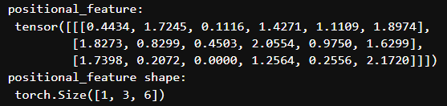
Layer – Positional Encoding
nb_positional_encoding.ipynb
import sys
sys.path.append('../')
import torch
from transformer.layer import PositionalEncoding
# Initiate parammeters
seq_len = 3
d_model = 6
batch_size = 1
dropout = 0.1
# Create an instance of our PositionalEncoding class
pos_encoding = PositionalEncoding(d_model, seq_len, dropout)
# Create a random embedded sequence
torch.manual_seed(68) # for reproducible result
x = torch.rand(batch_size, seq_len, d_model)
# Pass our sequences through the positional encoding
positional_feature = pos_encoding(x)
print("positional_feature: \n", positional_feature)
print("positional_feature shape: \n", positional_feature.shape)

Slide 104
Transformer building block

Slide 105
Layer – Multi Head Attention
layer.py
import torch
import torch.nn as nn
class MultiHeadAttention(nn.Module):
def __init__(self, d_model: int, h: int, dropout: float) -> None:
super().__init__()
self.d_model = d_model
self.h = h # Ensure that the embedding dimensionality is divisible by the number of heads.
assert d_model % h == 0, "d_model % num_heads should be zero"
self.d_k = d_model // h
# Initialize the linear transformations for the queries, keys, values, and output.
self.w_q = nn.Linear(d_model, d_model, bias=False)
self.w_k = nn.Linear(d_model, d_model, bias=False)
self.w_v = nn.Linear(d_model, d_model, bias=False)
self.w_o = nn.Linear(d_model, d_model, bias=False) # Initialize the dropout layer.
self.dropout = nn.Dropout(dropout)

Slide 106
Layer – Multi Head Attention
layer.py
# The attention function calculates the attention scores for a given query, key, and value.
@staticmethod
def attention(query_k, key_k, value_k, d_k, mask=None, dropout=nn.Dropout):
# query_k | key_k | value_k: [batch_size, h, seq_len, d_k]
# mask: [batch_size, 1, seq_len, seq_len]
# Calculate the attention scores.
attention_score = (query_k @ key_k.transpose(-2, -1)) / math.sqrt(d_k)
# Apply the mask, if provided.
if mask is not None:
attention_score = attention_score.masked_fill(mask == 0, -1e9)
# Apply the softmax and dropout function to the attention scores.
attention_score = torch.softmax(attention_score, dim=-1)
attention_score = dropout(attention_score)
# Return the weighted sum of the values, along with the attention scores.
# [batch_size, h, seq_len, d_k], [batch_size, h, seq_len, seq_len]
return (attention_score @ value_k, attention_score)

Slide 107
Layer – Multi Head Attention
layer.py
# The forward method is called when we pass input data into this layer.
def forward(self, query, key, value, mask=None):
# query | key | value: [batch_size, seq_len, d_model]
# mask: [batch_size, 1, seq_len, seq_len]
# Apply the linear transformations to the query, key, and value.
query_k = self.w_q(query)
key_k = self.w_k(key)
value_k = self.w_v(value)
# Reshape and transpose the queries, keys, and values
query_k = query_k.view(query_k.shape[0], query_k.shape[1], self.h, self.d_k).transpose(1, 2)
key_k = key_k.view(key_k.shape[0], key_k.shape[1], self.h, self.d_k).transpose(1, 2)
value_k = value_k.view(value_k.shape[0], value_k.shape[1], self.h, self.d_k).transpose(1, 2)

Slide 108
Layer – Multi Head Attention
layer.py
# Calculate the attention.
attention, _ = self.attention(query_k, key_k, value_k, self.d_k, mask, self.dropout)
# Concatenate the attention heads.
# [batch_size, h, seq_len, d_k] -> [batch_size, seq_len, h, d_k] -> [batch_size, seq_len, d_model]
attention = (attention.transpose(1, 2)
.contiguous()
.view(attention.shape[0], -1, self.d_model)
)
# Apply the output linear transformation and return the result.
return self.w_o(attention) # [batch_size, seq_len, d_model]

Slide 110
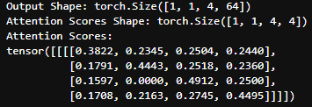
Attention without mask
nb_attention.ipynb
import sys
sys.path.append('../')
import torch
from transformer.layers import MultiHeadAttention
# Configuration setting
batch_size = 1
h = 1
seq_len = 4
d_k = 64
input_tensor = torch.rand(batch_size, h, seq_len, d_k)
query_k = input_tensor.clone()
key_k = input_tensor.clone()
value_k = input_tensor.clone()
# Call the attention function
output, attention_scores = MultiHeadAttention.attention(query_k, key_k, value_k, d_k, mask=None, dropout=nn.Dropout(0.1))
print(f"Output Shape: {output.shape}")
print(f"Attention Scores Shape: {attention_scores.shape}")
print(f"Attention Scores:\n{attention_scores}")

Slide 111
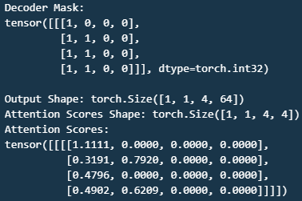
Attention with mask
nb_attention.ipynb
import torch
import torch.nn as nn
from transformer.layers import MultiHeadAttention
from transformer.mask import create_decoder_mask
# Configuration setting
batch_size = 1
h = 1
seq_len = 4
d_k = 64
# Initialize input tensors
torch.manual_seed(68) # for reproducible result input_tensor = torch.rand(batch_size, h, seq_len, d_k)
query_k = input_tensor.clone()
key_k = input_tensor.clone()
value_k = input_tensor.clone()
# Create decoder mask
decoder_input_ids = torch.tensor([ 2, 68, 0, 0])
pad_token_id = torch.tensor([0]) # padding token ID
decoder_mask = create_decoder_mask(decoder_input_ids, pad_token_id, seq_len)
# Call the attention function
output, attention_scores = MultiHeadAttention.attention(query_k, key_k, value_k, d_k, mask=decoder_mask, dropout=nn.Dropout(0.1))
print(…)

Slide 112
Layer – Multi Head Attention
nb_multi_head_attention.ipynb
import sys
sys.path.append('../')
import torch
from transformer.layer import MultiHeadAttention
# Initiate config
batch_size=1
seq_len=5
d_model = 6
h = 3
dropout = 0.1
# Create an instance of the MultiHeadAttention class
multi_head_attention = MultiHeadAttention(d_model, h, dropout)
# Create random tensors
torch.manual_seed(68) # for reproducible result
input_tensor = torch.rand(batch_size, seq_len, d_model)
# query, key, value.
query = input_tensor.clone()
key = input_tensor.clone()
value = input_tensor.clone()
# Call multi-head attention layer
attention = multi_head_attention(query, key, value)
print("attention: \n", attention)
print("attention shape: \n", attention.shape)

Slide 114
Transformer building block

Slide 115
Layer – Feed Forward
layer.py
import torch
import torch.nn as nn
class FeedForward(nn.Module):
def __init__(self, d_model: int, d_ff: int, dropout: float) -> None:
super().__init__()
# Initialize the first linear transformation, d_model → d_ff.
self.linear1 = nn.Linear(d_model, d_ff)
# Initialize the second linear transformation, d_ff → d_model.
self.linear2 = nn.Linear(d_ff, d_model)
# Initialize the dropout layer.
self.dropout = nn.Dropout(dropout)
def forward(self, x): # x: [batch_size, seq_len, d_model]
return self.linear2(
self.dropout(torch.relu(self.linear1(x)))) # [batch_size, seq_len, d_model].

Slide 116
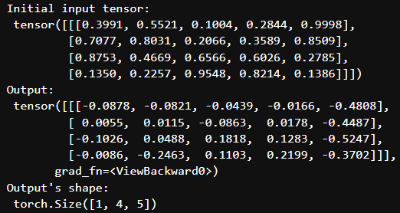
Layer – Feed Forward
nb_feed_forward.ipynb
import sys
sys.path.append('../')
import torch
from transformer.layer import FeedForward
# Initiate configuration
d_model = 5
batch_size=1
seq_len=4
d_ff = 2048
dropout = 0.1
# Create an instance of the FeedForward class
ff = FeedForward(d_model, d_ff, dropout)
# Create a random tensor to represent a batch of sequences
torch.manual_seed(68) # for reproducible result of random process
x = torch.rand(batch_size, seq_len, d_model)
# Pass the tensor through the feed-forward network
output = ff(x)
print("Initial input tensor: \n", x)
print("Output: \n", output)
print("Output's shape: \n", output.shape)

Slide 118
Transformer building block

Slide 119
Layer – Layer Normalization
layer.py
class LayerNorm(nn.Module):
def __init__(self, d_model: int, eps: float = 1e-6) -> None:
super().__init__()
# Initialize the scale and shift parameters, which are learnable.
self.para_mul = nn.Parameter(torch.ones(d_model))
self.para_bias = nn.Parameter(torch.zeros(d_model))
# Store the epsilon value.
self.eps = eps
def forward(self, x): # x: [batch_size, seq_len, d_model]
# Calculate the mean and standard deviation of the input
mean = x.mean(dim=-1, keepdim=True)
std = x.std(dim=-1, keepdim=True)
# Scale and shift the normalized value, [batch_size, seq_len, d_model]
return (self.para_mul * (x - mean) / (std + self.eps) + self.para_bias)

Slide 120
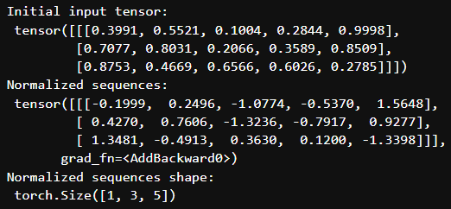
Layer – Layer Normalization
nb_layer_normalization.ipynb
import sys
sys.path.append('../')
import torch
from transformer.layer import LayerNorm
# Initiate configuration
d_model = 5
batch_size = 1
seq_len = 3
# Create an instance of our LayerNorm class
layer_norm = LayerNorm(d_model)
# Create a random tensor to represent a batch of sequences
torch.manual_seed(68) # for reproducible result
x = torch.rand(batch_size, seq_len, d_model)
# Pass our sequences through the layer normalization
normalized_sequences = layer_norm(x)
print("Initial input tensor: \n", x)
print("Normalized sequences: \n", normalized_sequences)
print("Normalized sequences shape: \n", normalized_sequences.shape)

Slide 122
Transformer building block

Slide 123
Layer – Residual Connection
layer.py
class ResidualConnection(nn.Module):
def __init__(self, d_model: int, dropout: float) -> None:
super().__init__()
# Initialize the layer normalization layer.
self.norm = LayerNorm(d_model)
# Initialize the dropout layer.
self.dropout = nn.Dropout(dropout)
def forward(self, x, sublayer): # x: [batch_size, seq_len, d_model]
# Apply layer normalization to the input, passes the result through the sublayer
return x + self.dropout(sublayer(self.norm(x))) # [batch_size, seq_len, d_model]

Slide 124
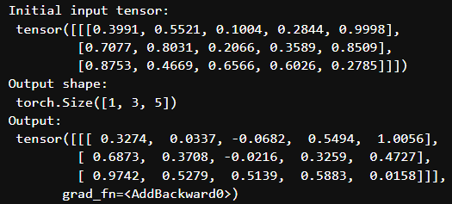
Layer – Residual Connection
nb_residual_connection.ipynb
import sys
sys.path.append('../')
import torch
from transformer.layer import FeedForward, ResidualConnection
# Initiate configuration
d_model = 5
d_ff=2048
batch_size=1
seq_len=3
dropout = 0.1
# Create an instance of the ResidualConnection and FeedForward classes
residual_connection = ResidualConnection(d_model, dropout)
feed_forward = FeedForward(d_model, d_ff=d_ff, dropout=dropout)
# Create a random input tensor
torch.manual_seed(68) # reproducible
x = torch.rand(batch_size, seq_len, d_model)
# Call residual connection
output = residual_connection(x, feed_forward)
print("Initial input tensor: \n", x)
print("Output shape: \n", output.shape)
print("Output: \n", output)

Slide 126
Transformer building block

Slide 127
Layer – Projection
layer.py
class Projection(nn.Module):
def __init__(self, d_model: int, vocab_size: int) -> None:
super().__init__()
# Initialize the linear transformation
# that projects the input into the vocabulary space.
self.projection = nn.Linear(d_model, vocab_size)
def forward(self, x): # x: [batch_size, seq_len, d_model]
# It applies the linear transformation to the input.
return self.projection(x) # [batch_size, seq_len, vocab_size].

Slide 128
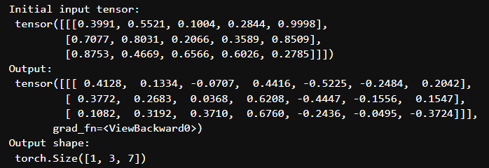
Layer – Projection
nb_projection.ipynb
import sys
sys.path.append('../')
import torch
from transformer.layer import Projection
# Initiate configuration
d_model = 5
vocab_size = 7
batch_size=1
seq_len=3
# Create an instance of the Projection class
projection = Projection(d_model, vocab_size)
# Create a random tensor to represent a batch of sequences
torch.manual_seed(68) # for reproducible result
x = torch.rand(batch_size, seq_len, d_model)
# Pass the tensor through the projection
output = projection(x)
print("Initial input tensor: \n", x)
print("Output: \n", output)
print("Output shape: \n", output.shape)

Slide 130
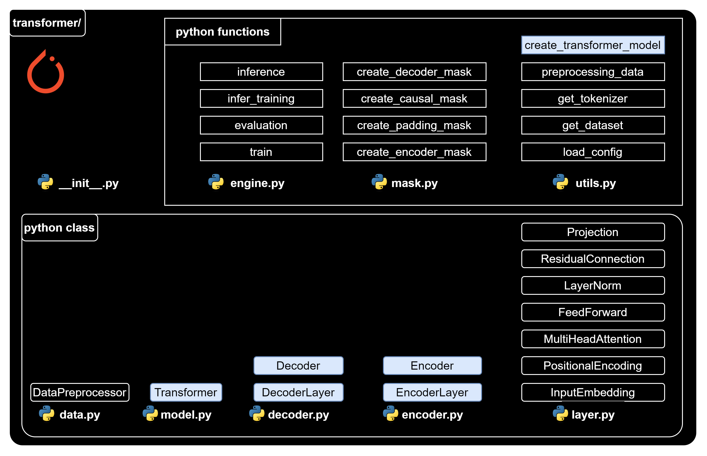
Class/function to create transformer

Slide 132
Class/function to create transformer

Slide 133
Encoder Layer
encoder.py
import torch.nn as nn
from transformer.layer import FeedForward, MultiHeadAttention, ResidualConnection, LayerNorm
class EncoderLayer(nn.Module):
def __init__(self, d_model: int, self_attention: MultiHeadAttention, feed_forward: FeedForward, dropout: float,
) -> None:
super().__init__()
self.self_attention = self_attention
self.feed_forward = feed_forward
# Initialize the residual connections.
self.residual_connections = nn.ModuleList([ResidualConnection(d_model, dropout) for _ in range(2)])

Slide 134
Encoder Layer
encoder.py
def forward(self, x, mask_scr=None):
# x: [batch_size, seq_len, d_model]
# First, it applies the self-attention mechanism to the input inside a residual connection.
x = self.residual_connections[0](x, lambda x: self.self_attention(x, x, x, mask_scr))
# Then, it passes the result through the feed-forward network inside another residual connection.
x = self.residual_connections[1](x, self.feed_forward)
return x # [batch_size, seq_len, d_model].

Slide 136
Class/function to create transformer

Slide 137
Encoder
encoder.py
class Encoder(nn.Module):
def __init__(self, d_model: int, encoder_layer: EncoderLayer, num_layers: int) -> None:
super().__init__()
# Initialize the layers of the encoder.
self.layers = nn.ModuleList([encoder_layer for _ in range(num_layers)])
# Initialize the layer normalization.
self.norm = LayerNorm(d_model)

Slide 138
Encoder
encoder.py
# The forward method is called when we pass input data into this module.
def forward(self, x, mask_scr=None):
# x: [batch_size, seq_len, d_model]
# It passes the input through each layer in turn.
for layer in self.layers:
x = layer(x, mask_scr)
# Finally, it applies layer normalization to the output of the last layer.
return self.norm(x) # [batch_size, seq_len, d_model].

Slide 139
Playground - Encoder
nb_encoder.ipynb
import torch
from transformer.layer import MultiHeadAttention, FeedForward, LayerNorm
from transformer.encoder import EncoderLayer, Encoder
# Define configuration
d_model = 6 # feature dimension
h = 3 # number of heads
dropout = 0.1 # dropout ratio
d_ff = 2048 # the dimension of the feed forward network
batch = 1 # batch size
seq_len = 4 # sequence length num_layers = 3 # number of encoder layer
# Create an instance of the MultiHeadAttention & FeedForward classes
self_attention_engine = MultiHeadAttention(d_model, h, dropout)
feed_forward = FeedForward(d_model, d_ff, dropout)
# Create an instance of the EncoderLayer class
encoder_layer = EncoderLayer(d_model, self_attention_engine, feed_forward, dropout)
# Create an instance of the Encoder class
encoder = Encoder(d_model, encoder_layer, num_layers)

Slide 140

Playground - Encoder
nb_encoder.ipynb
# Create a random tensor to represent a batch of sequences
torch.manual_seed(68) # for reproducible result of random process
x = torch.rand(batch, seq_len, d_model)
# Pass the tensor through the encoder
output = encoder(x)
print("Initial input tensor: \n", x)
print("Encoder Output: \n", output)
print("Encoder Output's shape: \n", output.shape)

Slide 142
Class/function to create transformer

Slide 143
Decoder Layer
decoder.py
import torch.nn as nn
from transformer.layer import FeedForward, MultiHeadAttention, ResidualConnection, LayerNorm
class DecoderLayer(nn.Module):
def __init__(self, d_model: int, self_attention: MultiHeadAttention,
encoder_decoder_attention: MultiHeadAttention,
feed_forward: FeedForward, dropout: float) -> None:
super().__init__()
self.self_attention_engine = self_attention
self.encoder_decoder_attention = encoder_decoder_attention
self.feed_forward = feed_forward
# Initialize the residual connections.
self.residual_connections =
nn.ModuleList([ResidualConnection(d_model, dropout) for _ in range(3)])

Slide 144
Decoder Layer
decoder.py
def forward(self, x, encoder_output, mask_src=None, mask_tgt=None):
# x: [batch_size, seq_de, d_model], encoder_output: [batch_size, seq_len, d_model]
x = self.residual_connections[0](x, lambda x: self.self_attention_engine(x, x, x, mask_tgt))
x = self.residual_connections[1](x, lambda x: self.encoder_decoder_attention(x, encoder_output, encoder_output, mask_src))
x = self.residual_connections[2](x, self.feed_forward)
return x

Slide 146
Class/function to create transformer

Slide 147
Decoder
decoder.py
class Decoder(nn.Module):
def __init__(self, d_model: int, decoder_layer: DecoderLayer, num_layers: int) -> None:
super().__init__()
# Initialize the layers of the decoder.
self.layers = nn.ModuleList([decoder_layer for _ in range(num_layers)])
# Initialize the layer normalization.
self.norm = LayerNorm(d_model)

Slide 148
Decoder
decoder.py
def forward(self, x, encoder_output, mask_src=None, mask_tgt=None):
# x: [batch_size, seq_len, d_model]
# It passes the input and the encoder output through each layer in turn.
for layer in self.layers:
x = layer(x, encoder_output, mask_src, mask_tgt)
# Finally, it applies layer normalization to the output of the last layer.
return self.norm(x) # [batch_size, seq_len, d_model].

Slide 149
Playground Decoder
nb_decoder.ipynb
import torch
from transformer.layer import MultiHeadAttention, FeedForward, LayerNorm
from transformer.decoder import DecoderLayer, Decoder
# Define configuration
d_model = 6 # feature dimension
h = 6 # number of heads
dropout = 0.1 # dropout ratio
d_ff = 2048 # the dimension of the feed forward network
batch_size = 1 # batch size
seq_len = 4 # sequence length
num_layers = 3 # number of encoder layer
# Create an instance of the MultiHeadAttention and FeedForward classes
self_attention = MultiHeadAttention(d_model, h, dropout)
encoder_decoder_attention = MultiHeadAttention(d_model, h, dropout)
feed_forward = FeedForward(d_model, d_ff, dropout)
# Create an instance of the DecoderLayer class
decoder_layer = DecoderLayer(d_model, self_attention, encoder_decoder_attention, feed_forward, dropout)

Slide 150

Playground Decoder
nb_decoder.ipynb
# Create an instance of the Decoder class
decoder = Decoder(d_model, decoder_layer, num_layers)
# Create a random tensor to represent a batch of sequences
torch.manual_seed(68) # for reproducible result of random process
x = torch.rand(batch_size, seq_len, d_model)
torch.manual_seed(101) # for reproducible result of random process
encoder_output = torch.rand(batch_size, seq_len, d_model)
# Pass the tensor through the decoder
output = decoder(x, encoder_output)
print("Initial input tensor: \n", x)
print("Encoder output tensor: \n", encoder_output)
print("Decoder Output: \n", output)
print("Decoder Output's shape: \n", output.shape)

Slide 152
Class/function to create transformer

Slide 153
Transformer class
model.py
import torch.nn as nn
from transformer.layer import InputEmbedding, PositionalEncoding, Projection
from transformer.encoder import Encoder
from transformer.decoder import Decoder
class Transformer(nn.Module):
def __init__(self, encoder: Encoder,
decoder: Decoder,
embed_src: InputEmbedding,
embed_tgt: InputEmbedding,
pos_src: PositionalEncoding,
pos_tgt: PositionalEncoding,
projection: Projection,
) -> None:
super().__init__()
self.encoder = encoder
self.decoder = decoder
self.embed_src = embed_src
self.embed_tgt = embed_tgt
self.pos_src = pos_src
self.pos_tgt = pos_tgt
self.projection = projection

Slide 154
Transformer class
model.py
def encode(self, src, mask_src=None):
src = self.embed_src(src)
src = self.pos_src(src)
return self.encoder(src, mask_src)
def decode(self, tgt, encoder_output, mask_src=None, mask_tgt=None):
tgt = self.embed_tgt(tgt)
tgt = self.pos_tgt(tgt)
return self.decoder(tgt, encoder_output, mask_src, mask_tgt)
def project(self, x):
return self.projection(x)

Slide 156
Class/function to create transformer

Slide 157
Utils – Create transformer model
utils.py
def create_tranformer_model(config, vocab_size_src, vocab_size_tgt) -> Transformer:
# Extract parameters from the configuration
d_model = config["d_model"]
num_layers = config["num_layers"]
h = config["h"]
d_ff = config["d_ff"]
dropout = config["dropout"]
seq_len = config["seq_len"]
# Initialize the source and target embedding layers
embed_src = InputEmbedding(vocab_size_src, d_model)
embed_tgt = InputEmbedding(vocab_size_tgt, d_model)

Slide 158
Utils – Create transformer model
utils.py
# Initialize the source & target positional encoding layers
pos_src = PositionalEncoding(d_model, seq_len, dropout)
pos_tgt = PositionalEncoding(d_model, seq_len, dropout)
# Initialize the encoder with self-attention and feed-forward layers
self_attention_encoder = MultiHeadAttention(d_model, h, dropout)
feed_forward_encoder = FeedForward(d_model, d_ff, dropout)
encoder_layer = EncoderLayer(
d_model, self_attention_encoder, feed_forward_encoder, dropout)
encoder = Encoder(d_model, encoder_layer, num_layers)

Slide 159
Utils – Create transformer model
utils.py
# Initialize the decoder with self-attention, encoder-decoder attention, and feed-forward layers
self_attention_decoder = MultiHeadAttention(d_model, h, dropout)
encoder_decoder_attention = MultiHeadAttention(d_model, h, dropout)
feed_forward_decoder = FeedForward(d_model, d_ff, dropout)
decoder_layer = DecoderLayer(
d_model,
self_attention_decoder,
encoder_decoder_attention,
feed_forward_decoder,
dropout,
)
decoder = Decoder(d_model, decoder_layer, num_layers)
# Initialize the projection layer
projection = Projection(d_model, vocab_size_tgt)

Slide 160
Utils – Create transformer model
utils.py
# Initialize the Transformer model
transformer = Transformer(
encoder,
decoder,
embed_src,
embed_tgt,
pos_src,
pos_tgt,
projection,
)
# Initialize the model parameters with Xavier uniform distribution
for param in transformer.parameters():
if param.dim() > 1:
nn.init.xavier_uniform_(param)
return transformer

Slide 161
Put it all together – Playground transformer
nb_transformer.ipynb
import sys
sys.path.append('../')
import torch
from transformer.utils import create_tranformer_model
from transformer.utils import load_config, get_dataset, get_tokenizer
## Get Config, dataset, tokenizers
config_file_path = "../config.json"
config = load_config(config_file_path)
dataset = get_dataset(config)
tokenizer_src = get_tokenizer(config, dataset, config['language_source'])
tokenizer_tgt = get_tokenizer(config, dataset, config['language_target'])
## Define model, random input and get random output
# Define the dimensions and vocabulary size
# Define the parameters for the transformer model
vocab_size_src = 10000
vocab_size_tgt = 10000
seq_len = 100
batch_size=1
# Create the transformer model
transformer = create_tranformer_model(
config,
vocab_size_src,
vocab_size_tgt,
)

Slide 162
Put it all together – Playground transformer
nb_transformer.ipynb
# Now you can use the transformer model for encoding, decoding, and projecting
# For example, to encode a batch of source sequences:
torch.manual_seed(68) # for reproducible result of random process
src = torch.randint(0, vocab_size_src, (batch_size, seq_len)) # [batch_size, seq_len]
encoder_output = transformer.encode(src)
# And to decode a batch of target sequences:
torch.manual_seed(101) # for reproducible result of random process
tgt = torch.randint(0, vocab_size_tgt, (batch_size, seq_len)) # [batch_size, seq_len]
decoder_output = transformer.decode(tgt, encoder_output)
# And to project the decoder output:
projected_output = transformer.project(decoder_output)
# predicted_token is the indice of the max value in projection_output
_, predicted_tokens_tensors = torch.max(projected_output, dim=1)
# Convert predicted tokens to numpy array
predicted_tokens = predicted_tokens_tensors.squeeze(0)
predicted_tokens = predicted_tokens.detach().cpu().numpy()

Slide 163
Put it all together – Playground transformer
nb_transformer.ipynb
## Find the EOS token
for idx, eos in enumerate(predicted_tokens):
if eos == 3:
eos_idx = idx
break
## Get predicted sequence until EOS
predicted_token_sequence = predicted_tokens[:eos_idx]
## Word decode
# Pass the tensor through the target tokenizer
decoded_words = tokenizer_tgt.decode(predicted_token_sequence)
print("Predicted sequence: \n", decoded_words)

Slide 166












Softmax function
$$\frac{e^{X_{i}}}{\sum_{j}^{N}{e^{X_{j}}}}$$
$$X_{i}$$
$$Y_{i}$$
$$\left[\begin{aligned}1 \\ 2 \\ 4\end{aligned}\right]$$
$$\left[\begin{aligned}\text{0.}\text{0420} \\ \text{0.}\text{11}\text{4}\text{2} \\ \text{0.}8438\end{aligned}\right]$$
$$X$$
$$Y$$
softmax
$$\left\{\begin{aligned}\left[0:1\right] \\ sum=1\end{aligned}\right.$$
$$\left[\begin{aligned}0.123 \\ 0.246 \\ −np.inf\end{aligned}\right]$$
$$\left[\begin{aligned}\text{0.4648} \\ \text{0.5352} \\ \text{0}\end{aligned}\right]$$
$$X$$
$$Y$$
softmax

Slide 167

Softmax function
nb_softmax_fn.ipynb
import torch
import numpy as np
# create an input tensor
input_tensor = torch.tensor([0.123, 0.264, -np.inf])
# apply softmax to the input tensor to obtain the output tensor
output_tensor = torch.softmax(input_tensor, dim=0)
print("input_tensor: \n", input_tensor)
print("output_tensor: \n", output_tensor)

Slide 169



Cross Entropy Loss
Context
Given a machine translation task of transformer
Translate French sentence to English sentence
Configurations
seq_len = 3
en_vocabulary_size = 4
english_tokenizer:
{"Am" : 0,"Fine": 1,"I": 2,
"Hi": 3}
1st step
Source sentence (Fr)
Predictions
Target sentence (En)
Modeling
Prediction
"Je
Vais
Bien"
[[0.3, 0.2, 0.4, 0.1],
"I
Am
Fine"
[2,
0,
1]
Transformer
[0.4, 0.1, 0.3, 0.2],
[0.3, 0.5, 0.1, 0.2]]
2nd step
softmax
Softmax
Select prob corresponding to true label
[[0.2612, 0.2363, 0.2887, 0.2138],
[0.2887, 0.2138, 0.2612, 0.2363],
[0.2535, 0.3096, 0.2075, 0.2294]]
3rd step
$$cross_entropy_loss$$
$$=$$
$$mean(−\log\left(0.2887, 0.2887, 0.3096\right))$$
Compute the negative log
Take average on the result
$$\frac{−\log\left(\text{0.2887}\right)−log⁡(\text{0.2887})−log⁡(\text{0}.3096)}{3}=1.2192$$
$$=$$

Slide 170

Cross Entropy Loss
nb_loss_fn.ipynb
import torch
import torch.nn.functional as F
# Suppose we have prediction
prediction = torch.tensor([[0.3, 0.2, 0.4, 0.1], [0.4, 0.1, 0.3, 0.2], [0.3, 0.5, 0.1, 0.2]]) # Suppose we have target indexes
target = torch.tensor([2, 0, 1])
# Apply softmax to the prediction
proba_sofmax = F.softmax(prediction, dim=1) # Select the probabilities corresponding to the true classes
selected_proba = proba_sofmax[range(len(target)), target]
# Compute the negative log likelihood loss
manual_cross_entropy_loss = -torch.log(selected_proba).mean()
# Print out results
print("prediction: {} \n".format(prediction))
print("target: {} \n".format(target))
print("proba_sofmax: {}\n".format(proba_sofmax))
print("selected_proba: {}\n".format(selected_proba))
print("manual_cross_entropy_loss: {}\n".format(manual_cross_entropy_loss))

Slide 171

Cross Entropy Loss
nb_loss_fn.ipynb
import torch
import torch.nn as nn
# Define the loss function
loss_fn = nn.CrossEntropyLoss()
# Suppose we have prediction
prediction = torch.tensor([[0.3, 0.2, 0.4, 0.1], [0.4, 0.1, 0.3, 0.2], [0.3, 0.5, 0.1, 0.2]])
# Suppose we have target indexes
target = torch.tensor([2, 0, 1])
# Compute the cross entropy loss
loss = loss_fn(prediction, target)
# Print out results
print("prediction: {} \n".format(prediction))
print("target: {} \n".format(target))
print("cross_entropy_loss: {} \n".format(loss))

Slide 172

Engine functions for training

Slide 174
Engine functions for training

Slide 175
Engine – Train
engine.py
import os
import torch
import torch.nn as nn
from torch.utils.tensorboard import SummaryWriter
import torchmetrics.text as metrics
from transformer.mask import create_causal_mask from tqdm import tqdm
from transformer.utils import create_tranformer_model, get_checkpoint_path, create_checkpoint_path,
from transformer.utils import preprocessing_data
def train(config):
# Assign the device for computation (GPU if available, else CPU)
device = torch.device("cuda" if torch.cuda.is_available() else "cpu")
print(f"Using {device} device")
# Initiate TensorBoard writer for logging training metrics
logs = SummaryWriter(config["log_dir"])

Slide 176
Engine – Train
engine.py
# Check if model directory exists, if not create one to save the model weights
if not os.path.exists(config["model_dir"]):
os.mkdir("models")
# Load and preprocess the dataset
(train_dataloader, val_dataloader, _, tokenizer_src, tokenizer_tgt,) = preprocessing_data(config)

Slide 177
Engine – Train
engine.py
# Get vocab size for source and target language
vocab_size_src = tokenizer_src.get_vocab_size()
vocab_size_tgt = tokenizer_tgt.get_vocab_size()
# Create the Transformer model
model = create_tranformer_model(config, vocab_size_src, vocab_size_tgt).to(device)
# Initialize the optimizer (Adam in this case)
optimizer = torch.optim.Adam(model.parameters(), lr=config["learning_rate"], eps=1e- 9)
initial_epoch = 0
global_step = 0
# Get the checkpoint path if exists
checkpoint_path = get_checkpoint_path(config)

Slide 178
Engine – Train
engine.py
# If a checkpoint exists, load the model and optimizer states and continue training from the last epoch
if checkpoint_path:
print(f"Loading checkpoint from {checkpoint_path}")
checkpoint = torch.load(checkpoint_path)
model.load_state_dict(checkpoint["model_state_dict"])
initial_epoch = checkpoint["epoch"] + 1
optimizer.load_state_dict(checkpoint["optimizer_state_dict"])
global_step = checkpoint["global_step"]
else:
print("No checkpoint found")

Slide 179
Engine – Train
engine.py
# Define the loss function (CrossEntropyLoss in this case)
loss_function = nn.CrossEntropyLoss(ignore_index=tokenizer_src.token_to_id("[PAD]"), label_smoothing=0.1).to(device)
# Training loop
for epoch in range(initial_epoch, config["epochs"]):
torch.cuda.empty_cache()
model.train()
batch_iterator = tqdm(train_dataloader, desc=f"Training Epoch {epoch}")
# Iterate over each batch in the training data
for batch in batch_iterator:
# Move the encoder and decoder inputs and masks to the device
encoder_input = batch["encoder_input_ids"].to(device) # (batch_size, seq_len)
decoder_input = batch["decoder_input_ids"].to(device) # (batch_size, seq_len)
encoder_mask = batch["encoder_mask"].to(device) # (batch_size, 1, 1, seq_len)
decoder_mask = batch["decoder_mask"].to(device) # (batch_size, 1, seq_len, seq_len)

Slide 180
Engine – Train
engine.py
# Pass the inputs through the model # (batch_size, seq_len, d_model)
encoder_output = model.encode(encoder_input, encoder_mask)
#(batch_size, seq_len_de, d_model)
decoder_output = model.decode(decoder_input, encoder_output, encoder_mask, decoder_mask)
# (batch_size, seq_len, vocab_size)
projection_output = model.project(decoder_output)
# Load target/label sequences # (batch_size, seq_len)
decoder_target = batch["decoder_target_ids"].to(device)

Slide 181
Engine – Train
engine.py
# Calculate loss
loss = loss_function(projection_output.view(-1, vocab_size_tgt), decoder_target.view(-1))
batch_iterator.set_postfix({"Training Loss": loss.item()})
# Log the loss to TensorBoard
logs.add_scalar("Training Loss", loss.item(), global_step)
logs.flush()
# Perform backpropagation
loss.backward()
# Update parameters
optimizer.step()
optimizer.zero_grad(set_to_none=True)
global_step += 1

Slide 182
Engine – Train
engine.py
# Run validation at the end of each epoch
evaluation(
model,
val_dataloader,
tokenizer_src,
tokenizer_tgt,
config["seq_len"],
global_step,
logs,
config["num_eval_samples"],
device,
)

Slide 183
Engine – Train
engine.py
# Save model checkpoint
model_checkpoint_path = create_checkpoint_path(config, f"{epoch:02d}")
torch.save(
{
"epoch": epoch,
"model_state_dict": model.state_dict(),
"optimizer_state_dict": optimizer.state_dict(),
"global_step": global_step,
},
model_checkpoint_path,
)

Slide 185
Engine functions for training

Slide 186
Engine – Evaluation during training
engine.py
def evaluation(model, val_dataloader, tokenizer_src, tokenizer_tgt, seq_len, global_step, logs, num_eval_samples, device):
# Set the model to evaluation mode
model.eval()
# Get the IDs for the start and end of sequence tokens
sos_id = tokenizer_src.token_to_id("[SOS]")
eos_id = tokenizer_src.token_to_id("[EOS]")
# Initialize lists to store the source texts, target texts, and predicted texts
source_texts = []
target_texts = []
predicted_texts = []

Slide 187
Engine – Evaluation during training
engine.py
# Disable gradient calculations
with torch.no_grad():
# Iterate over the validation data
for batch in val_dataloader:
# Get the encoder input and mask from the batch and move them to the device
encoder_input = batch["encoder_input_ids"].to(device) # (batch_size, seq_len)
encoder_mask = batch["encoder_mask"].to(device) # (batch_size, 1, 1, seq_len)
# Assert that the batch size is 1 for evaluation
assert encoder_input.shape[0] == encoder_mask.shape[0] == 1, "Batch size must be 1 for evaluation"

Slide 188
Engine – Evaluation during training
engine.py
# Perform inference using the model
model_output = infer_training(model, encoder_input, encoder_mask, sos_id, eos_id, seq_len, device)
# Get the source text, target text, and predicted text from the batch
source_text = batch["text_src"][0]
target_text = batch["text_tgt"][0]
predicted_text = tokenizer_tgt.decode(model_output.detach().cpu().numpy())
# Append the texts to their respective lists
source_texts.append(source_text)
target_texts.append(target_text)
predicted_texts.append(predicted_text)

Slide 189
Engine – Evaluation during training
engine.py
# Print the source text, target text, and predicted text
print(f"Source: {source_text}")
print(f"Target: {target_text}")
print(f"Predicted: {predicted_text}")
print("--------------------------------------------------")
# Break the loop if the number of evaluation samples has been reached
if len(source_texts) == num_eval_samples:
print("*************** EVALUATION COMPLETED - GO TO NEXT EPOCH ***************")
break

Slide 190
Engine – Evaluation during training
engine.py
if logs:
# calculate the BLEU score
bleu_metric = metrics.BLEUScore()
bleu_score = bleu_metric(predicted_texts, target_texts)
logs.add_scalar("Validation BLEU Score", bleu_score, global_step)
logs.flush()
# calculate the word error rate
wer_metric = metrics.WordErrorRate()
wer_score = wer_metric(predicted_texts, target_texts)
logs.add_scalar("Validation Word Error Rate", wer_score, global_step)
logs.flush()
# calculate character error rate
cer_metric = metrics.CharErrorRate()
cer_score = cer_metric(predicted_texts, target_texts)
logs.add_scalar("Validation Character Error Rate", cer_score, global_step)
logs.flush()

Slide 192
Engine functions for training

Slide 193
Engine – Inference during training
engine.py
def infer_training(model, encoder_input, encoder_mask, sos_id, eos_id, seq_len, device):
# Encode the input using the model # (batch_size, seq_len, d_model)
encoder_output = model.encode(encoder_input, encoder_mask)
# Initialize the decoder input with the start of sequence token
decoder_input = torch.tensor([[sos_id]]).type_as(encoder_input).to(device) # (1, 1)
# Loop until the sequence length of the decoder input equals the sequence length of the encoder input
while True:
if decoder_input.shape[1] == seq_len:
break

Slide 194
Engine – Inference during training
engine.py
# Create a causal mask for the decoder input
decoder_mask = create_causal_mask(decoder_input.shape[1]).type_as(encoder_mask).to(device)
# Decode the encoder output using the model
decoder_output = model.decode(decoder_input, encoder_output, encoder_mask, decoder_mask)
# select the last token from the seq_len dimension
last_token_output = decoder_output[:, -1, :]

Slide 195
Engine – Inference during training
engine.py
# project the output to the target vocab size
projection_output = model.project(last_token_output)
# predicted_token is the indice of the max value in projection_output, meaning the id in vocabulary
_, predicted_token = torch.max(projection_output, dim=1)
decoder_input = torch.cat([decoder_input, predicted_token.unsqueeze(0)
.type_as(encoder_input)
.to(device)], dim=1)
# Break the loop if the predicted token is the end of sequence token
if predicted_token == eos_id:
break
# Return the decoder input, removing the batch dimension
return decoder_input.squeeze(0)

Slide 197

Training in action
train.py
from transformer.engine import train
from transformer.utils import load_config
if __name__ == "__main__":
config_file_path = "config.json"
config = load_config(config_file_path)
train(config)

Slide 198


Training in action

Slide 200
Inference
Trained model
A sentence
Translated sentence

Slide 201

Engine function for inference

Slide 202
Inference
engine.py
def inference(src_text, model, tokenizer_src, tokenizer_tgt, seq_len, device):
# Set the model to evaluation mode.
model.eval()
# Disable gradient calculation.
with torch.no_grad():
# Tokenize the source text.
tokenized_src_text = tokenizer_src.encode(src_text)
# Calculate the number of padding tokens needed for the encoder input.
encoder_padding_num = seq_len - len(tokenized_src_text.ids) - 2 # 2: [SOS] & [EOS]
# Get the IDs of the special tokens.
sos_id = tokenizer_src.token_to_id("[SOS]")
eos_id = tokenizer_src.token_to_id("[EOS]")
pad_id = tokenizer_src.token_to_id("[PAD]")

Slide 203
Inference
engine.py
# Create the encoder input by concatenating the special tokens and the tokenized source text.
encoder_input = torch.cat(
[
torch.tensor([sos_id], dtype=torch.int64),
torch.tensor(tokenized_src_text.ids, dtype=torch.int64),
torch.tensor([eos_id], dtype=torch.int64),
torch.tensor([pad_id] * encoder_padding_num, dtype=torch.int64),
], dim=0
).to(device)
# Create the encoder mask.
encoder_mask = create_encoder_mask(encoder_input, pad_id).to(device)
# Encode the input.
encoder_output = model.encode(encoder_input, encoder_mask)
# Initialize the decoder input with the start of sequence token.
decoder_input = torch.tensor([[sos_id]]).type_as(encoder_input).to(device)

Slide 204
Inference
engine.py
# Loop until the sequence length is reached or the end of sequence token is predicted.
while True:
# Break the loop if the sequence length is reached.
if decoder_input.shape[1] == seq_len:
break
# Create the decoder mask.
decoder_mask = create_causal_mask(decoder_input.shape[1])
.type_as(encoder_mask)
.to(device)
# Decode the encoder output.
decoder_output = model.decode(
decoder_input,
encoder_output,
encoder_mask,
decoder_mask
)

Slide 205
Inference
engine.py
# Select the last token from the sequence length dimension.
last_token_output = decoder_output[:, -1, :]
# Project the output to the target vocabulary size.
projection_output = model.project(last_token_output)
# Get the predicted token by finding the index of the maximum value in the projection output.
_, predicted_token = torch.max(projection_output, dim=1)
# Update the decoder input by appending the predicted token.
decoder_input = torch.cat([
decoder_input, predicted_token.unsqueeze(0).type_as(encoder_input).to(device)
], dim=1)
# Break the loop if the predicted token is the end of sequence token.
if predicted_token == eos_id:
break

Slide 206
Inference
engine.py
# Decode the decoder input to get the translated text.
translated_text = tokenizer_tgt.decode(
decoder_input
.squeeze(0)
.detach()
.cpu()
.numpy()
)
return translated_text

Slide 208
Playground Inference – Machine translation
nb_inference.ipynb
import torch
from transformer.utils import create_tranformer_model
from transformer.utils import load_config, get_dataset, get_tokenizer
from transformer.utils import get_checkpoint_path
from transformer.engine import inference
# Assign the device for computation (GPU if available, else CPU)
device = torch.device("cuda" if torch.cuda.is_available() else "cpu")
print(f"Using {device} device")
## Get Config, dataset, tokenizers
config_file_path = "./config.json"
config = load_config(config_file_path)
dataset = get_dataset(config)
tokenizer_src = get_tokenizer(config, dataset, config['language_source'])
tokenizer_tgt = get_tokenizer(config, dataset, config['language_target'])
vocab_size_src = tokenizer_src.get_vocab_size()
vocab_size_tgt = tokenizer_tgt.get_vocab_size()
seq_len = config["seq_len"]

Slide 209
Playground Inference – Machine translation
nb_inference.ipynb
# Create the Transformer model
model = create_tranformer_model(config, vocab_size_src, vocab_size_tgt).to(device)
# Load latest checkpoint
model_checkpoint = get_checkpoint_path(config)
print("model_checkpoint:", model_checkpoint)
state = torch.load(model_checkpoint)
# Assign latest checkpoint to transfromer
model.load_state_dict(state['model_state_dict'])
# Source text to translate
source_text = "Market prices are shaped by the balance of supply and demand."
# call the translation function over the trained model and the source text translated_text = inference(source_text, model, tokenizer_src,
tokenizer_tgt, seq_len, device)

Slide 210

Playground Inference – Machine translation
nb_inference.ipynb
print("Source text: \n", source_text)
print(">>>>")
print("Translated text: \n", translated_text)

Slide 212
In summary
Implemented all building blocks of the Transformer.
Built the Transformer as a package.
Wrote a script to launch the training with several lines of code.
Tested the inference with the trained model for the use case of a machine translation task.
Provided a playground with notebooks for all functions and classes.

Slide 213
Thank you for your watching!
Subscribe, like, share

